Slide 1

G.PULLA REDDY ENGINEERING COLLEGE
(AUTONOMOUS), KURNOOL
REDUCTION OF COMMON MODE VOLTAGE USING VARIOUS CARRIER BASED PWM TECHNIQUES
BATCH NO: B6
NAME ROLL NO
B.SAI GOWTHAM TEJA 179X1A0208
B.SURESH 179X1A0207
N.LAVANYA 179X1A0269
D.RAMANJINEYULU 189X5A02E3
GUIDELINES BY
Dr. M. HARSHAVARDHAN REDDY
ASSOCIATE PROFESSOR
DEPARTMENT OF EEE

Slide 2
CONTENTS
Introduction
Two-level Inverter
Multilevel Inverter
Analysis of Multilevel Inverter Topologies
Conclusion

Slide 3
INTRODUCTION
Pulse Width Modulation (PWM) inverter has been widely applied to many ac motor drives, a number of problems such as motor bearing damages, electromagnetic interference (EMI), breakdown of winding insulation, and motor leakage current have been reported. It has been clarified that the common mode voltage itself as well as the dv/dt of this voltage in inverter-fed AC motor drives are responsible for the most of these problems. Also, conventional inverters generate high frequency common mode voltage.
Multilevel inverter is an alternative solution for high power & medium voltage A.C Drive. The present work explores control of common mode voltage and reduction in THD (Total Harmonic Distortion) for three-phase motor drives using different Multilevel Inverter Topologies employing various carrier based pulse width modulation techniques such as PD, POD and APOD.

Slide 4
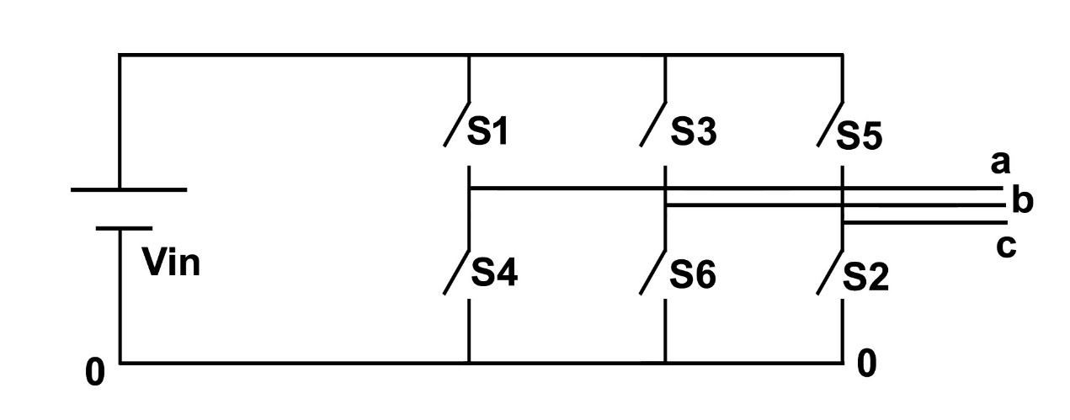
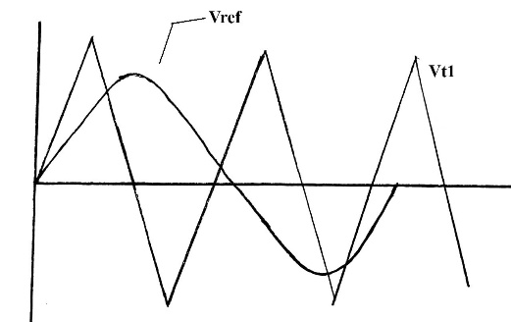
TWO-LEVEL INVERTER
An Inverter whose pole voltages can have two levels of voltages is called Two level inverter. A two-level Inverter creates two different voltages for the load i.e, suppose we are providing Vdc as an input to a two level inverter then it will provide either + Vdc/2 and – Vdc/2 or V and 0 on output.
In order to build an AC voltage, these two newly generated voltages are usually switched. For switching mostly PWM Techniques are used such as SPWM Technique.
Although this method of creating AC is effective but it has few drawbacks as it creates harmonic distortions in the output voltage, high common mode voltage also has a high dv/dt as compared to that of a multilevel inverter. Normally this method works but in few applications it creates problems particularly those where low distortion in the output voltage is required.
Fig. Two level inverter
Fig. Carrier Comparison Approach

Slide 5
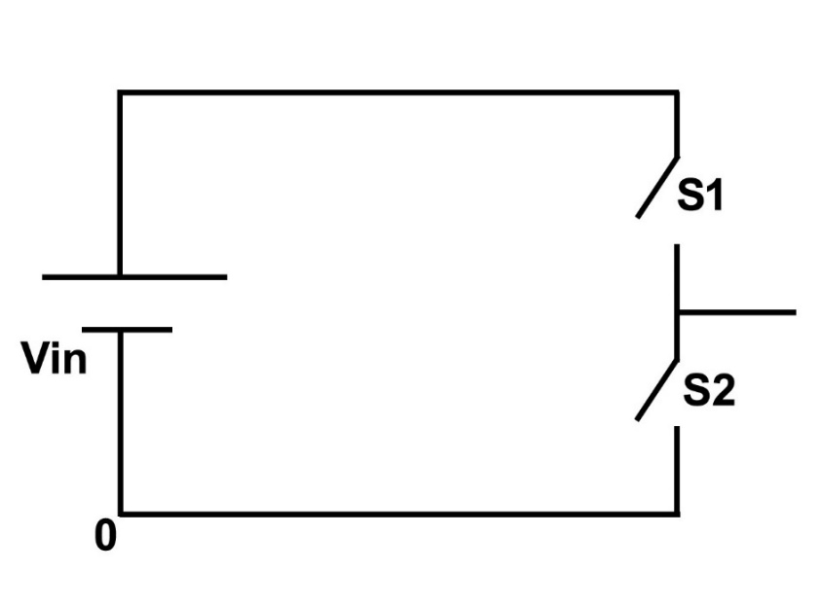
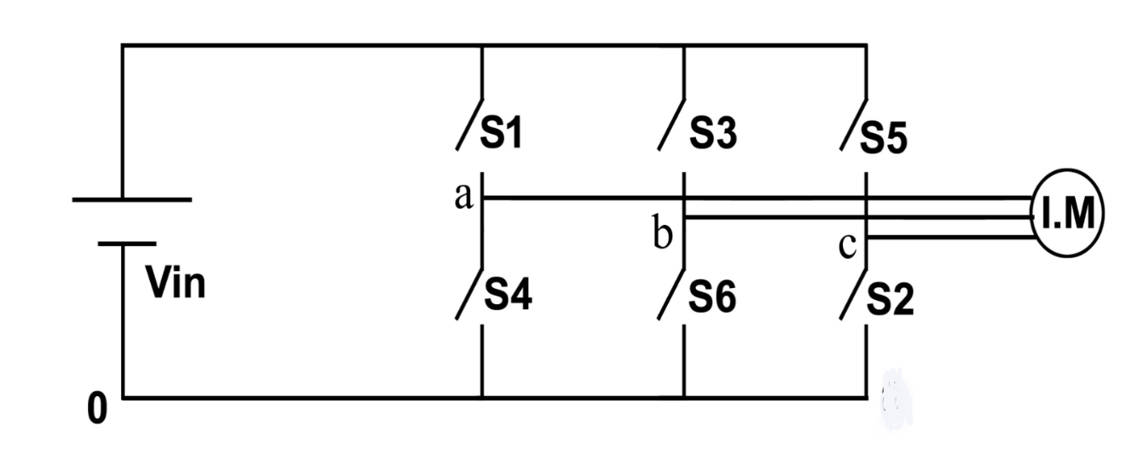
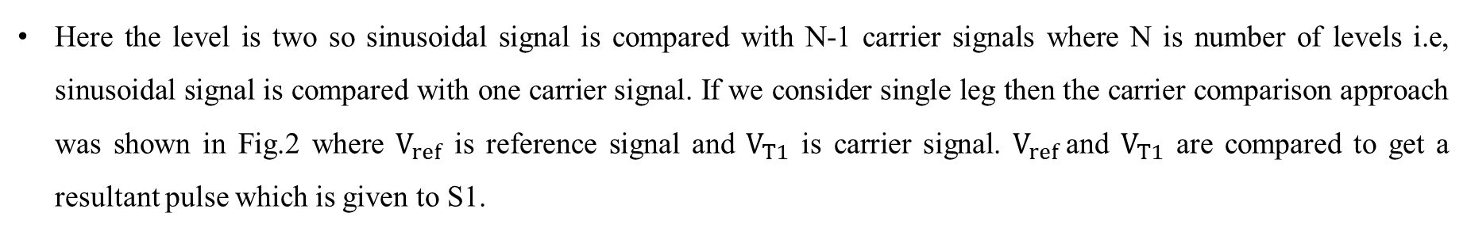
There are a total of six active switches, each equipped with an antiparallel freewheeling diode.. Switches S1,S2,S3 are positive group switches and S4,S6,S2 are negative group switches. S1-S4,S3-S6 and S5-S2 complementary pairs of switches
Here the level is two so sinusoidal signal is compared with N-1 carrier signals where N is number of levels i.e, sinusoidal signal is compared with one carrier signal. If we consider single leg then the carrier comparison approach was shown in Fig.2 where $V_{ref}$ is reference signal and $V_{T1}$ is carrier signal. $V_{ref}$and $V_{T1}$ are compared to get a resultant pulse which is given to S1.
Here S1-S2 are complementary pair of switches. If switch S1 is in ON condition then S2 will be in OFF condition vice versa. Here the input voltage is Vin. When S1 is turned ON the pole voltage will be Vin and when S2 is turned ON then the pole voltage will be 0.
Fig. Single leg circuit
Fig. Two level Inverter fed Induction Motor Drive

Slide 6
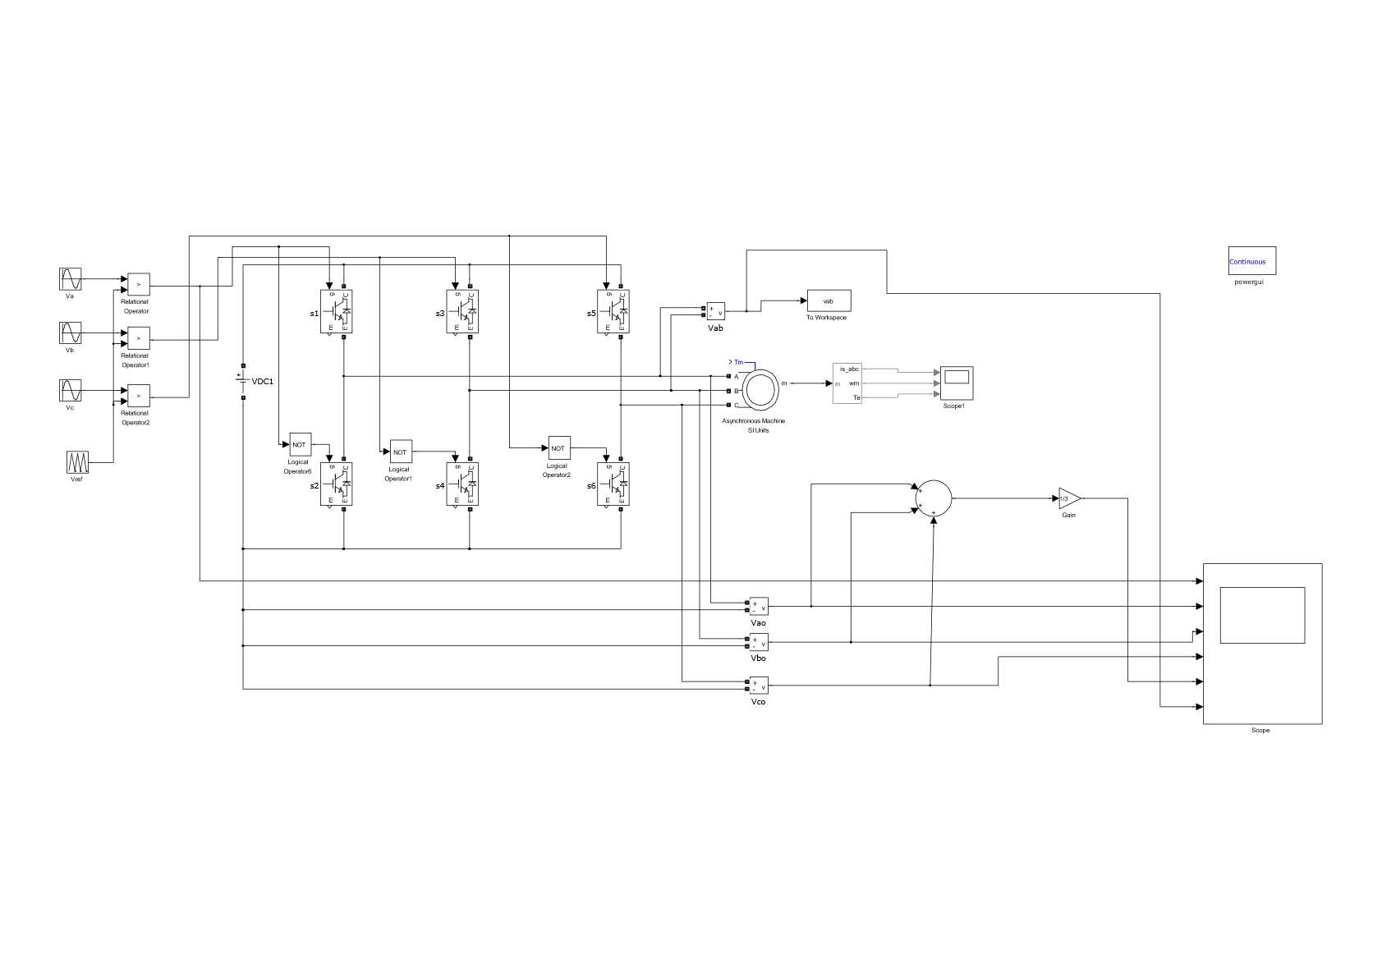
SIMULATION MODEL
Fig. Simulink model of Two level Inverter fed Induction Motor Drive

Slide 7
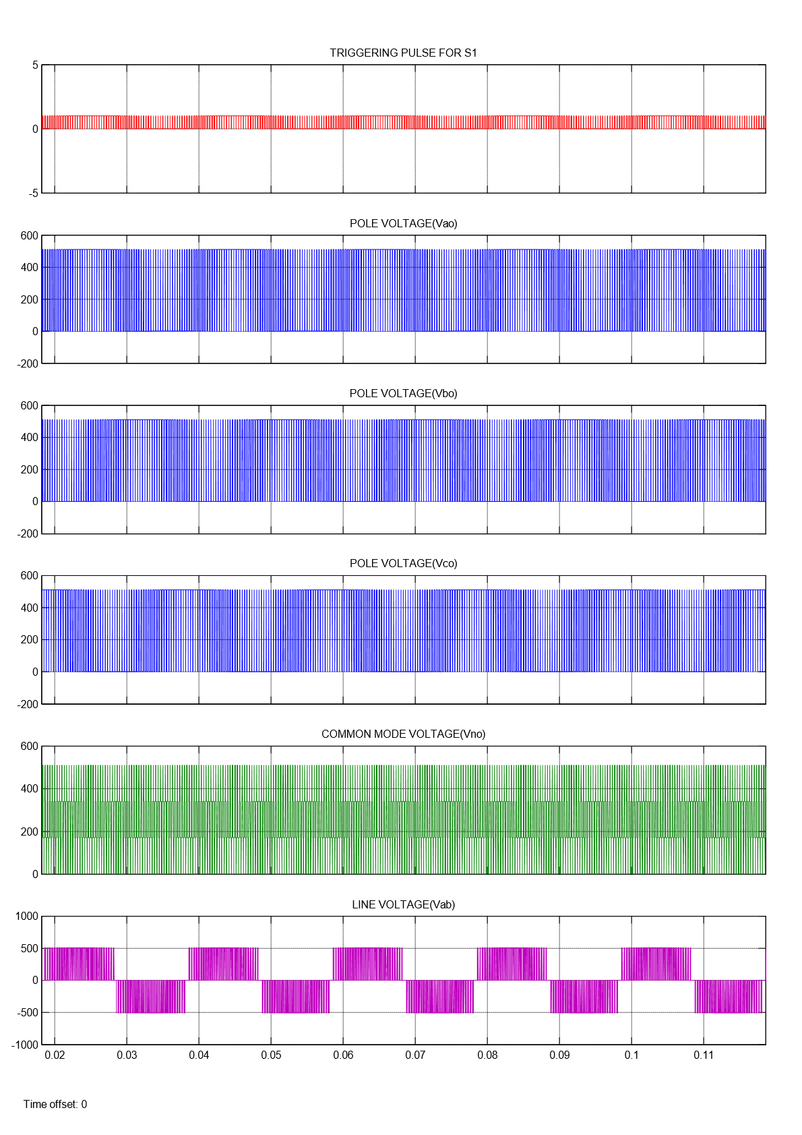
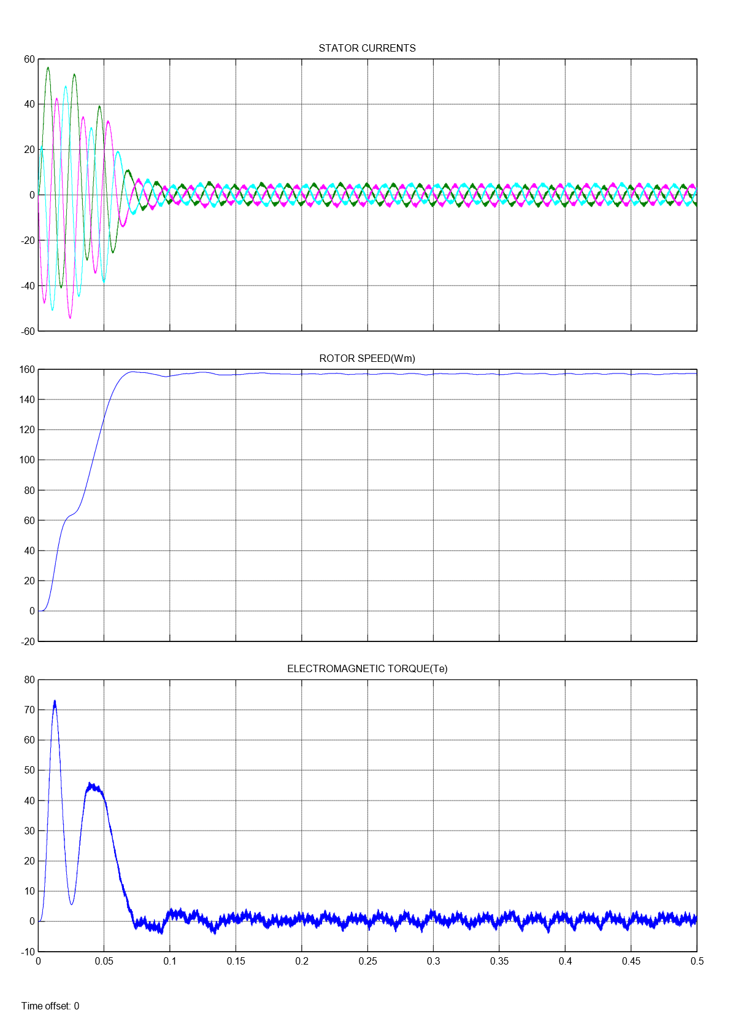
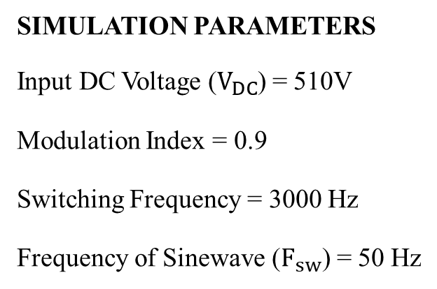
SIMULATION RESULTS
SIMULATION PARAMETERS
Input DC Voltage ($V_{DC}$) = 510V
Modulation Index = 0.9
Switching Frequency = 3000 Hz
Frequency of Sinewave ($F_{sw}$) = 50 Hz

Slide 8
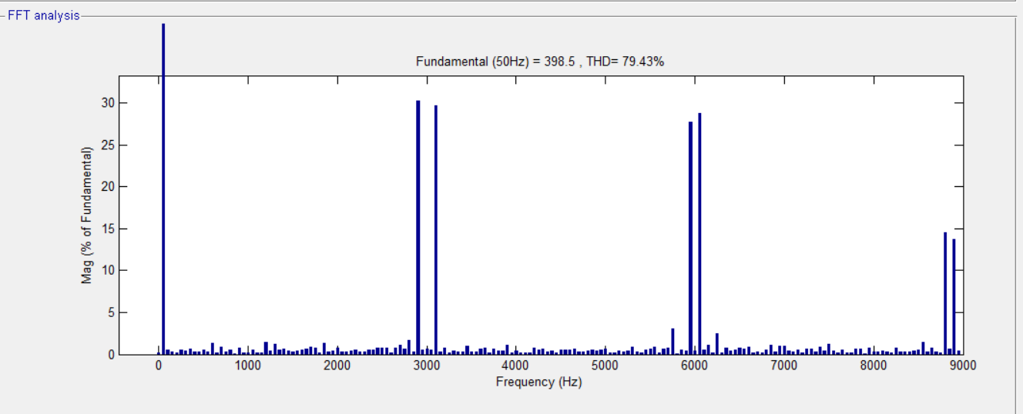
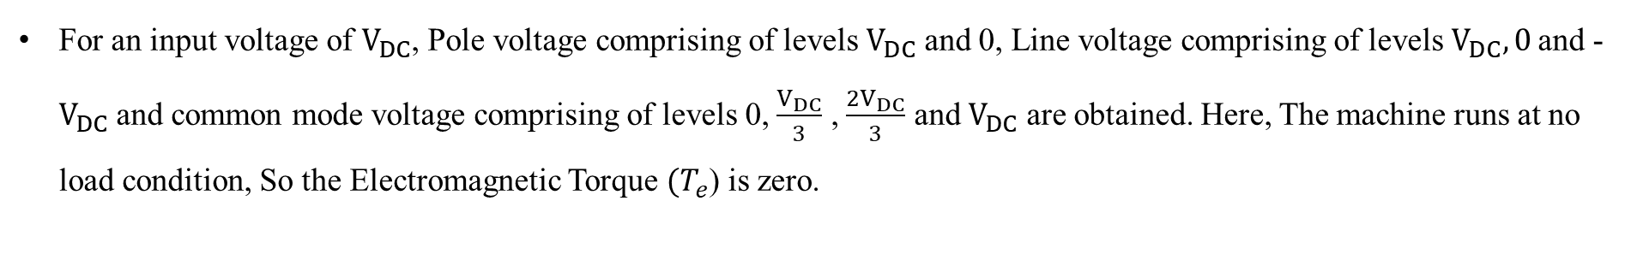
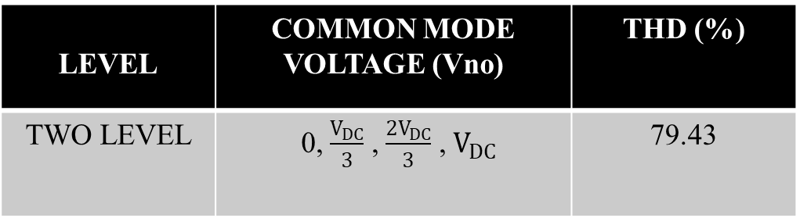
For an input voltage of $V_{DC}$, Pole voltage comprising of levels $V_{DC}$ and 0, Line voltage comprising of levels $V_{DC}, 0$and -$V_{DC}$ and common mode voltage comprising of levels 0, $\frac{V_{DC}}{3}$ , $\frac{2V_{DC}}{3}$ and $V_{DC}$ are obtained. Here, The machine runs at no load condition, So the Electromagnetic Torque ${(T}_{e}$) is zero.
LEVEL | COMMON MODE VOLTAGE (Vno) | THD (%)
TWO LEVEL | 0, $\frac{V_{DC}}{3}$ , $\frac{2V_{DC}}{3}$ , $V_{DC}$ | 79.43
Results of Two level Inverter
FFT Analysis for Two level Inverter

Slide 9
MULTILEVEL INVERTER
A multilevel inverter is a power electronic device which is capable of providing desired alternating voltage level at the output using multiple lower level DC voltages as an input.
The concept of Multilevel Inverter (MLI) is kind of modification of two-level inverter. In multilevel inverters we don’t deal with the two level voltage instead in order to create a smoother stepped output waveform, more than two voltage levels are combined together and the output waveform obtained in this case has lower dv/dt , lower common mode voltages and also lower harmonic distortions.
Smoothness of the waveform is proportional to the voltage levels, as we increase the voltage level the waveform becomes smoother but the complexity of controller circuit and components also increases along with the increased levels.

Slide 10
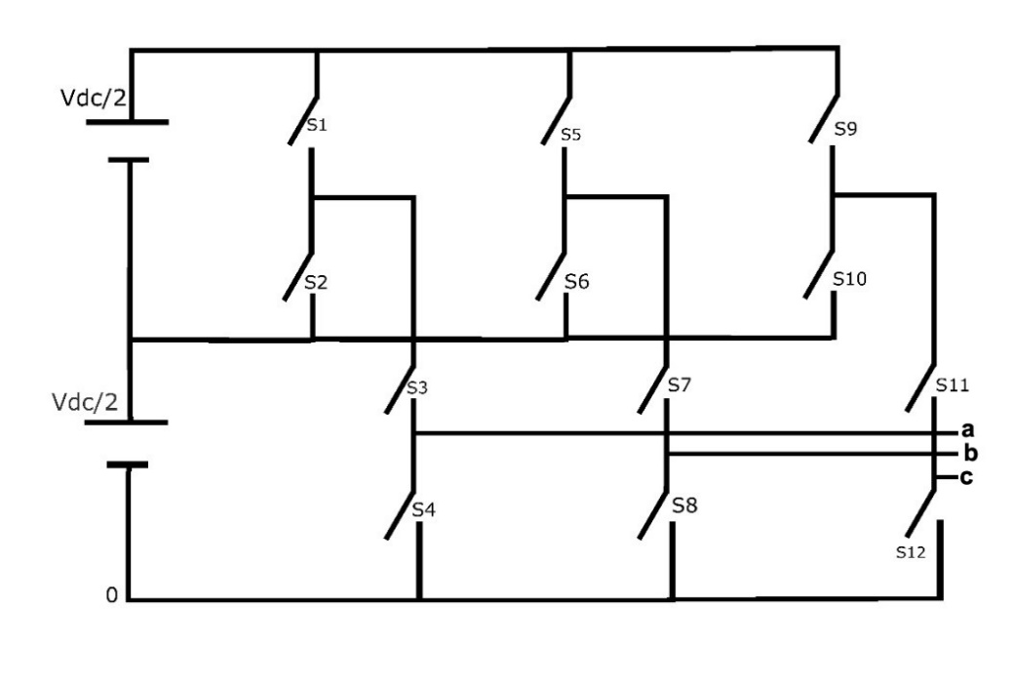
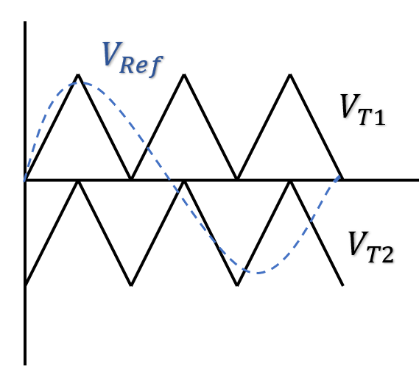
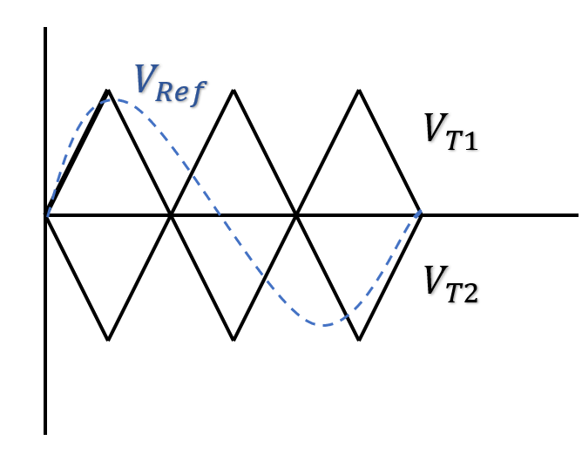
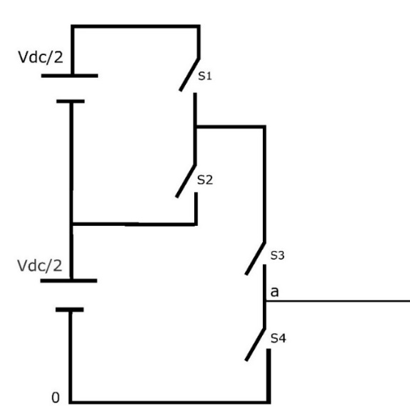
THREE LEVEL INVERTER
An inverter that produces three levels in the output pole voltage is called Three level Inverter. A Three level Inverter creates three different voltages for the load i.e, suppose if V is the input voltage to three level inverter then it will provide either V, + V/2 and 0 on output.
Suppose if one leg was considered from the main circuit then S1-S2 and S3-S4 are the complementary pairs of switches.
PD SPWM Technique and POD SPWM Technique are employed here
Fig. Three level Inverter
PD POD
In Phase Disposition all the carrier signals are in same phase. In Phase Opposition Disposition all the carrier signals above zero are out of phase with those below the zero by 180°.
Fig. Single leg
of Three Level Inverter

Slide 11
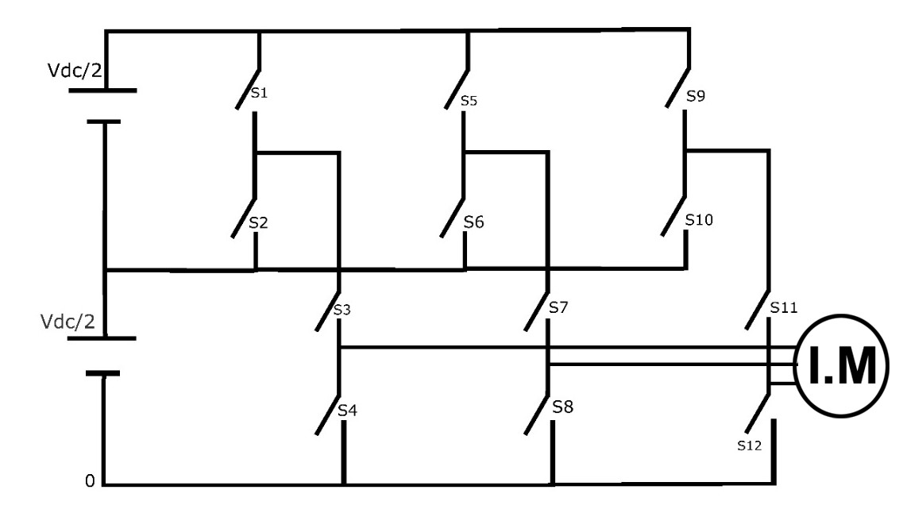
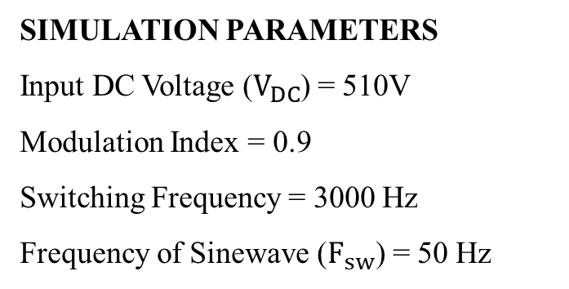
The voltages of this three level inverter for given input are Vdc, Vdc/2 ,0. The operation of the circuit is for the first instant S1(ON/OFF) , S2(ON/OFF),S3(ON) and S4(OFF) the pole voltage will be Vdc, Vdc/2 and for the second instant S1(OFF) , S2(ON), S3(ON/OFF) and S4(ON/OFF) the pole voltage for this instant will be Vdc/2, 0.
SIMULATION PARAMETERS
Input DC Voltage ($V_{DC}$) = 510V
Modulation Index = 0.9
Switching Frequency = 3000 Hz
Frequency of Sinewave ($F_{sw}$) = 50 Hz
Fig. Three Level Inverter fed Induction Motor drive

Slide 12
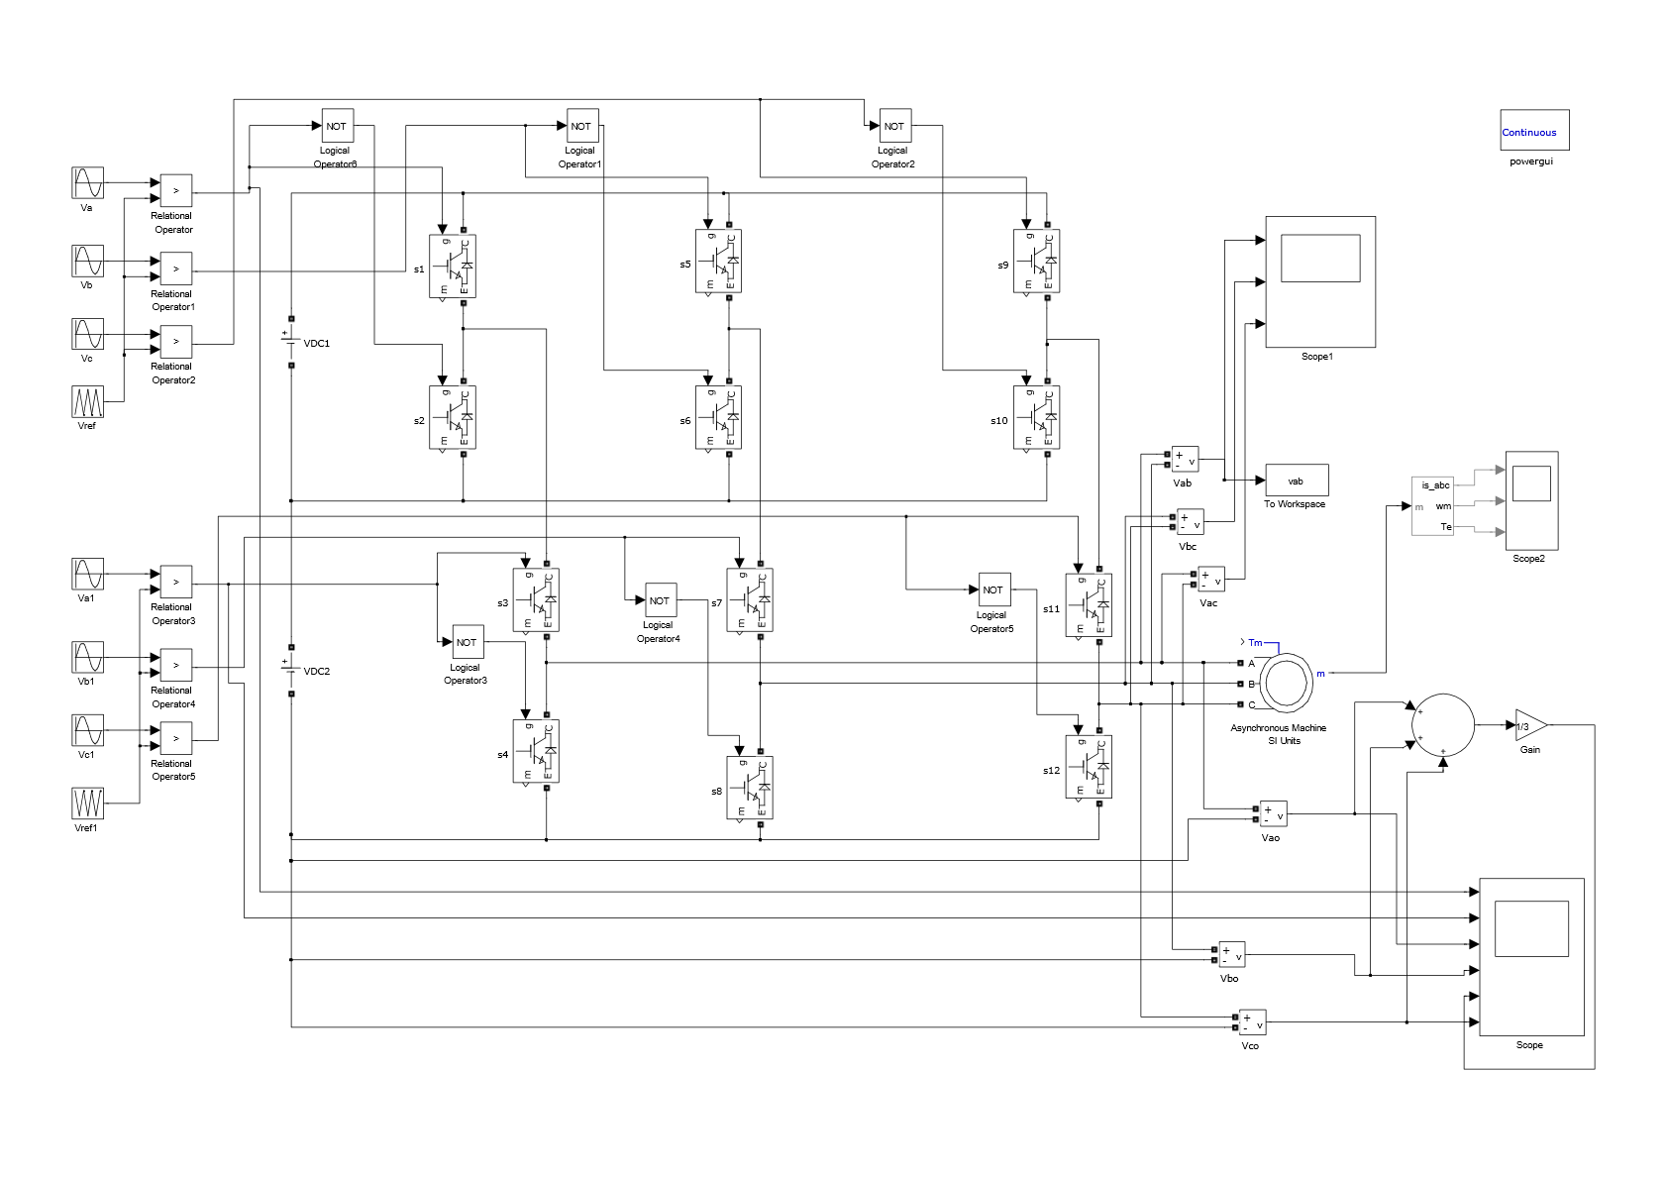
SIMULATION MODEL
Fig. Simulink Model of Three Level Inverter fed Induction Motor drive

Slide 13
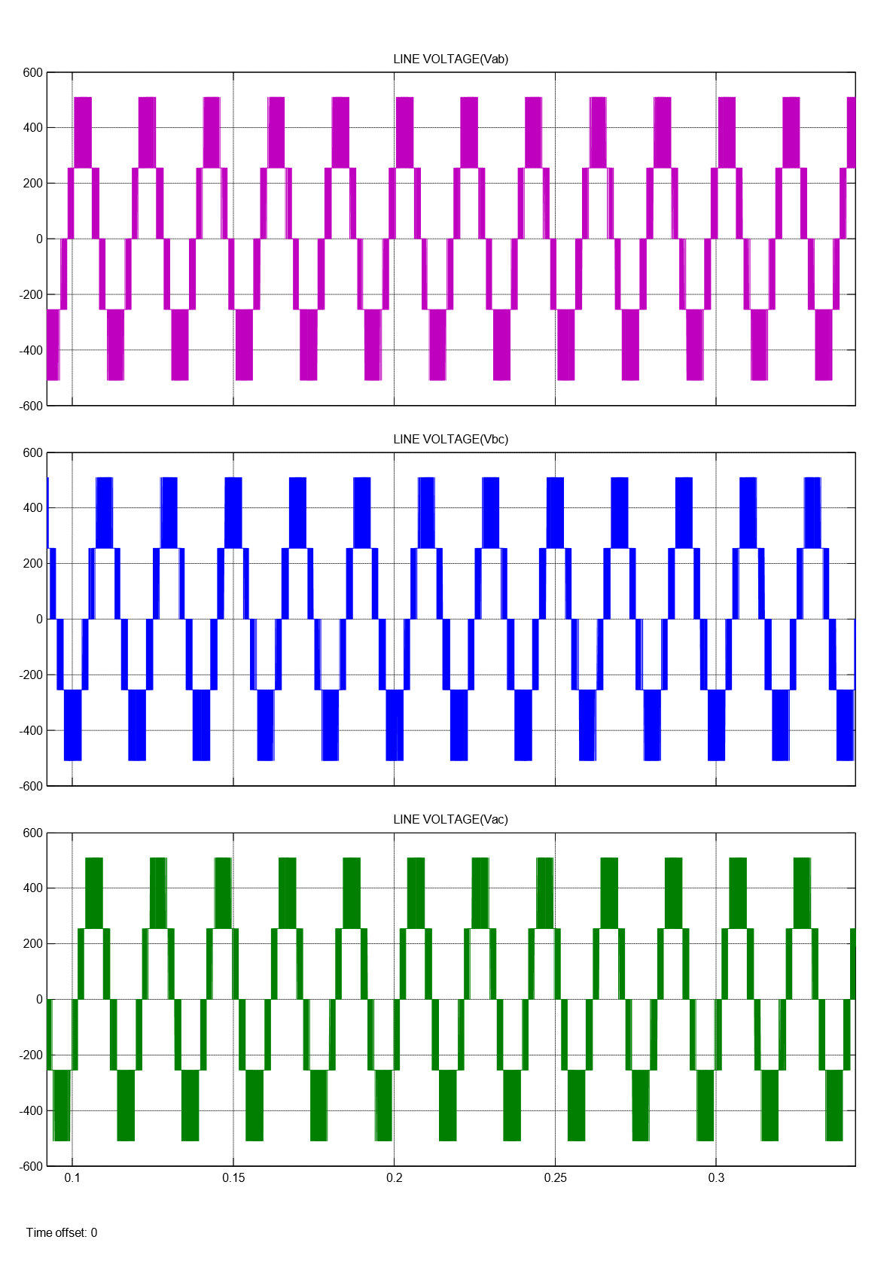
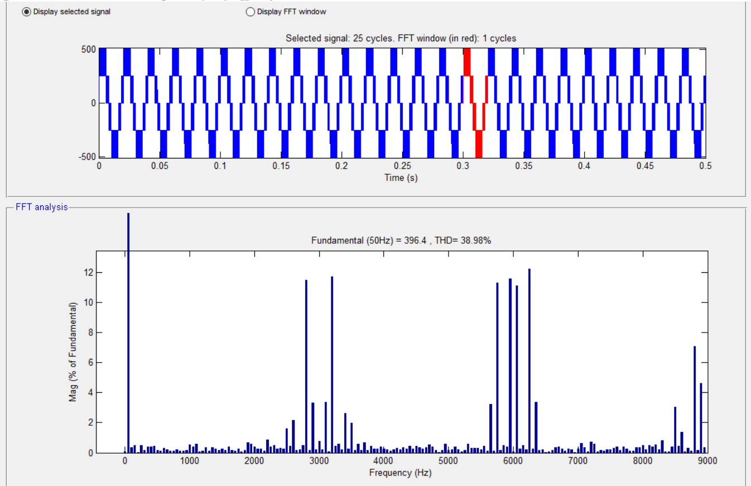
SIMULATION RESULTS (FOR PD):
FFT Analysis Three level Inverter (PD SPWM)

Slide 14
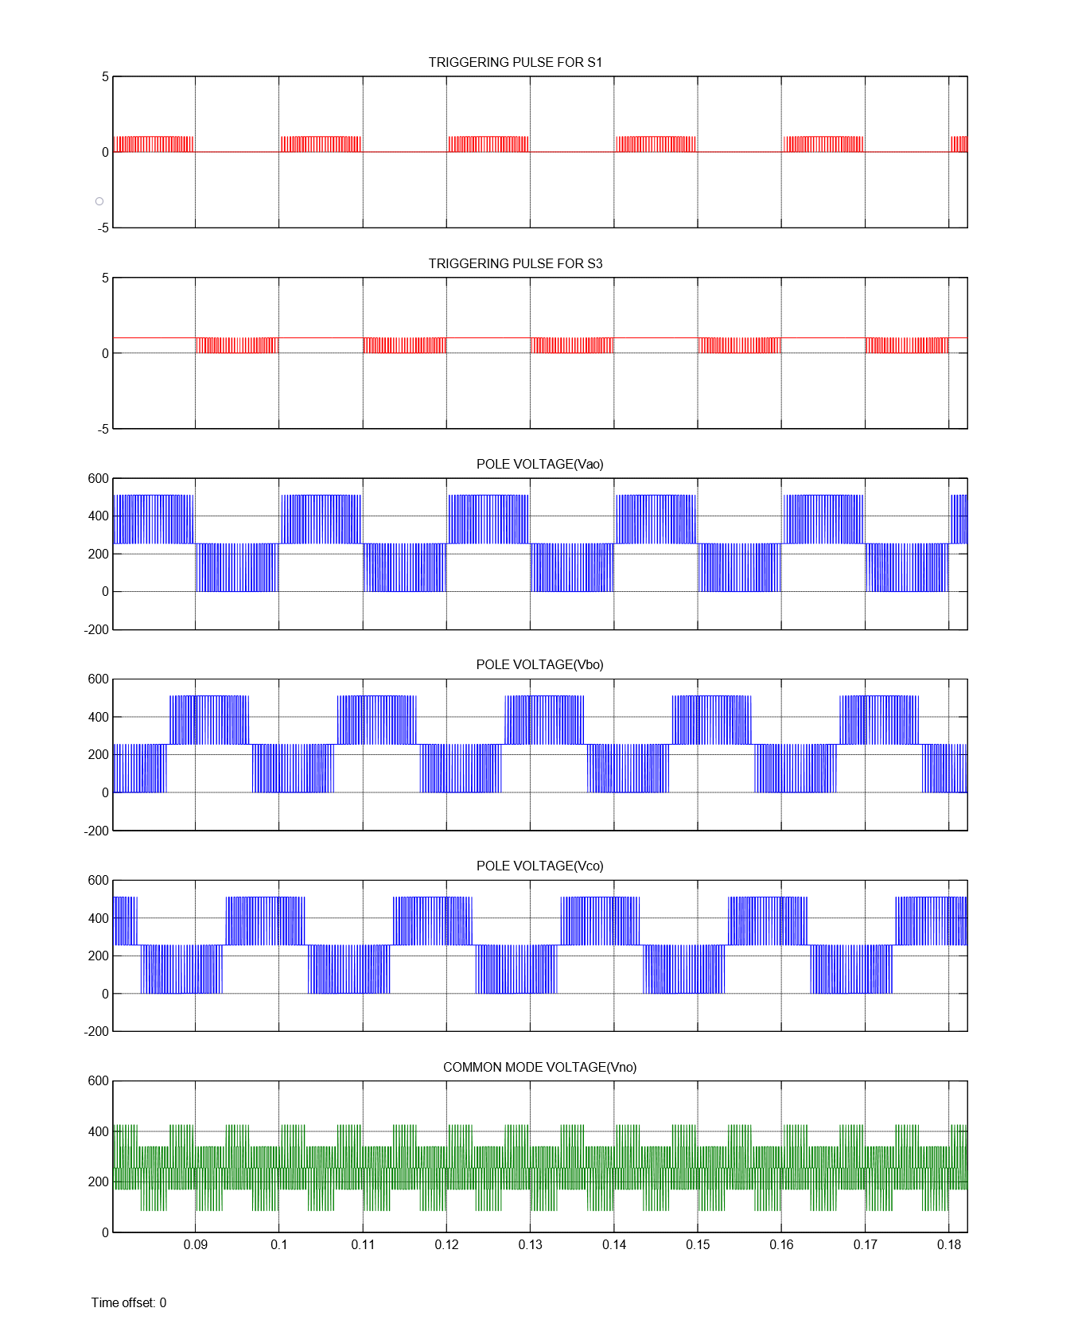
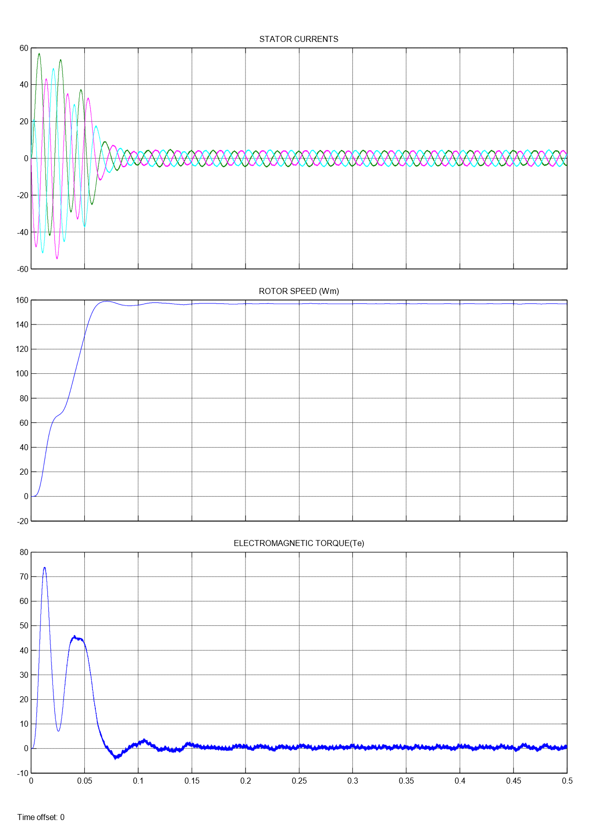
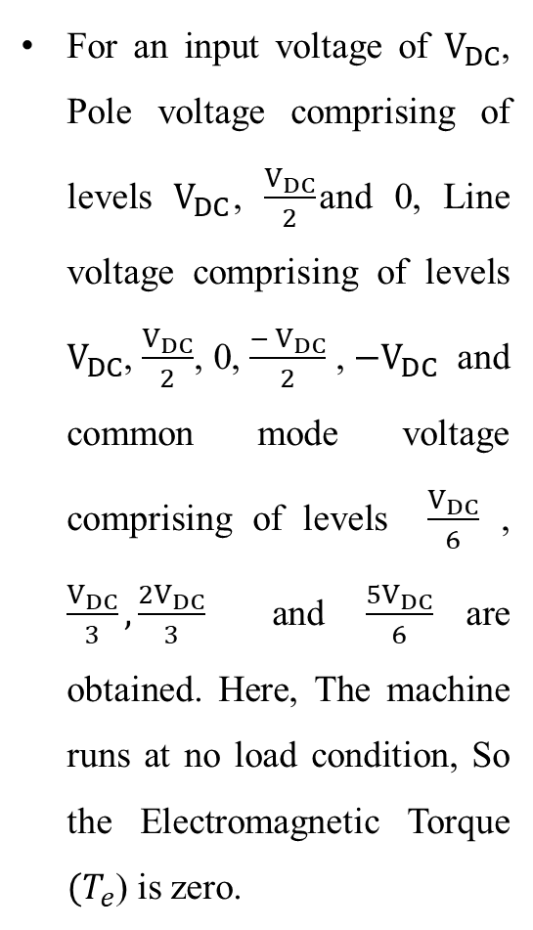
For an input voltage of $V_{DC}$, Pole voltage comprising of levels $V_{DC}$, $\frac{V_{DC}}{2}$and 0, Line voltage comprising of levels $V_{DC}$, $\frac{V_{DC}}{2}$, 0, $\frac{− V_{DC}}{2}$ , ${−V}_{DC}$ and common mode voltage comprising of levels $\frac{V_{DC}}{6}$ , $\frac{V_{DC}}{3}, \frac{2V_{DC}}{3}$ and $\frac{5V_{DC}}{6}$are obtained. Here, The machine runs at no load condition, So the Electromagnetic Torque ${(T}_{e}$) is zero.

Slide 15
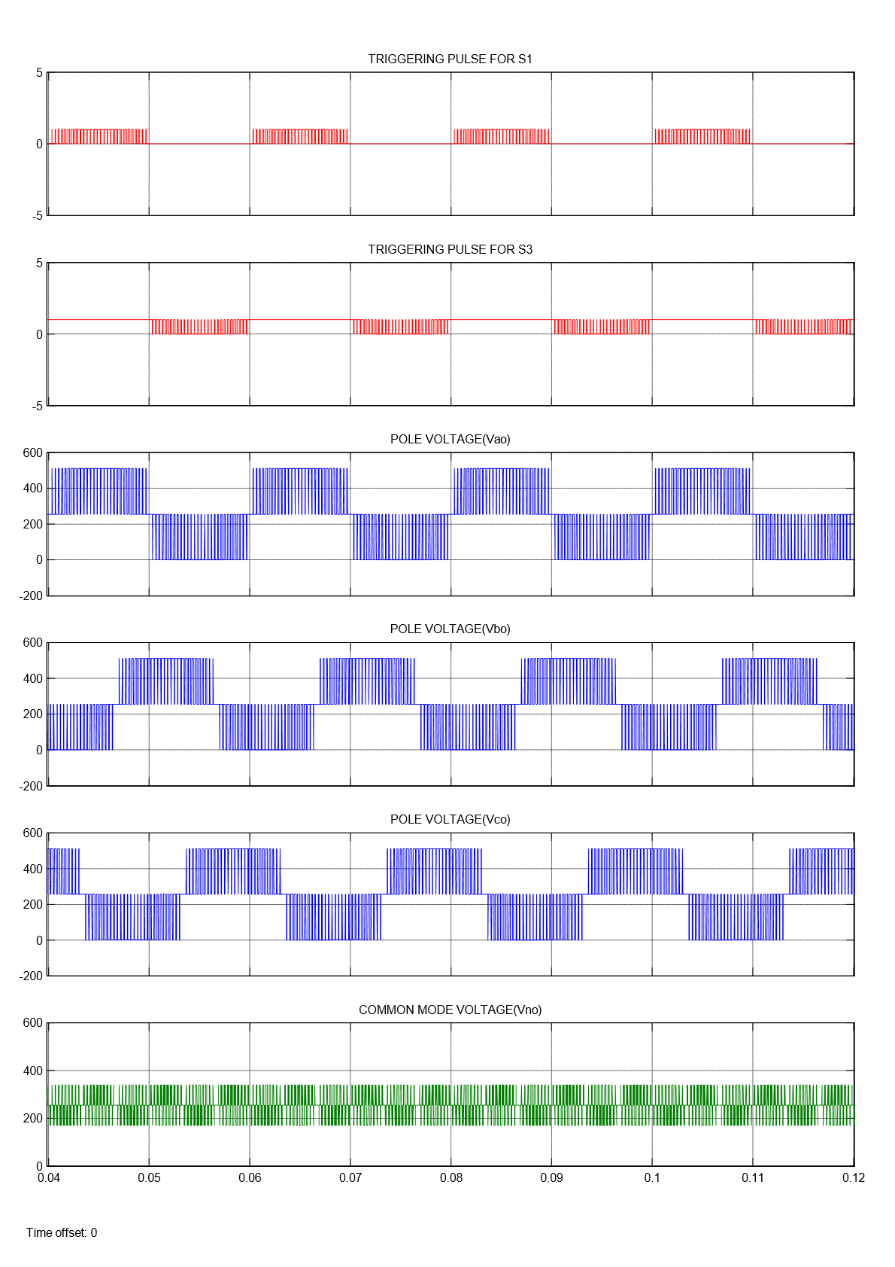
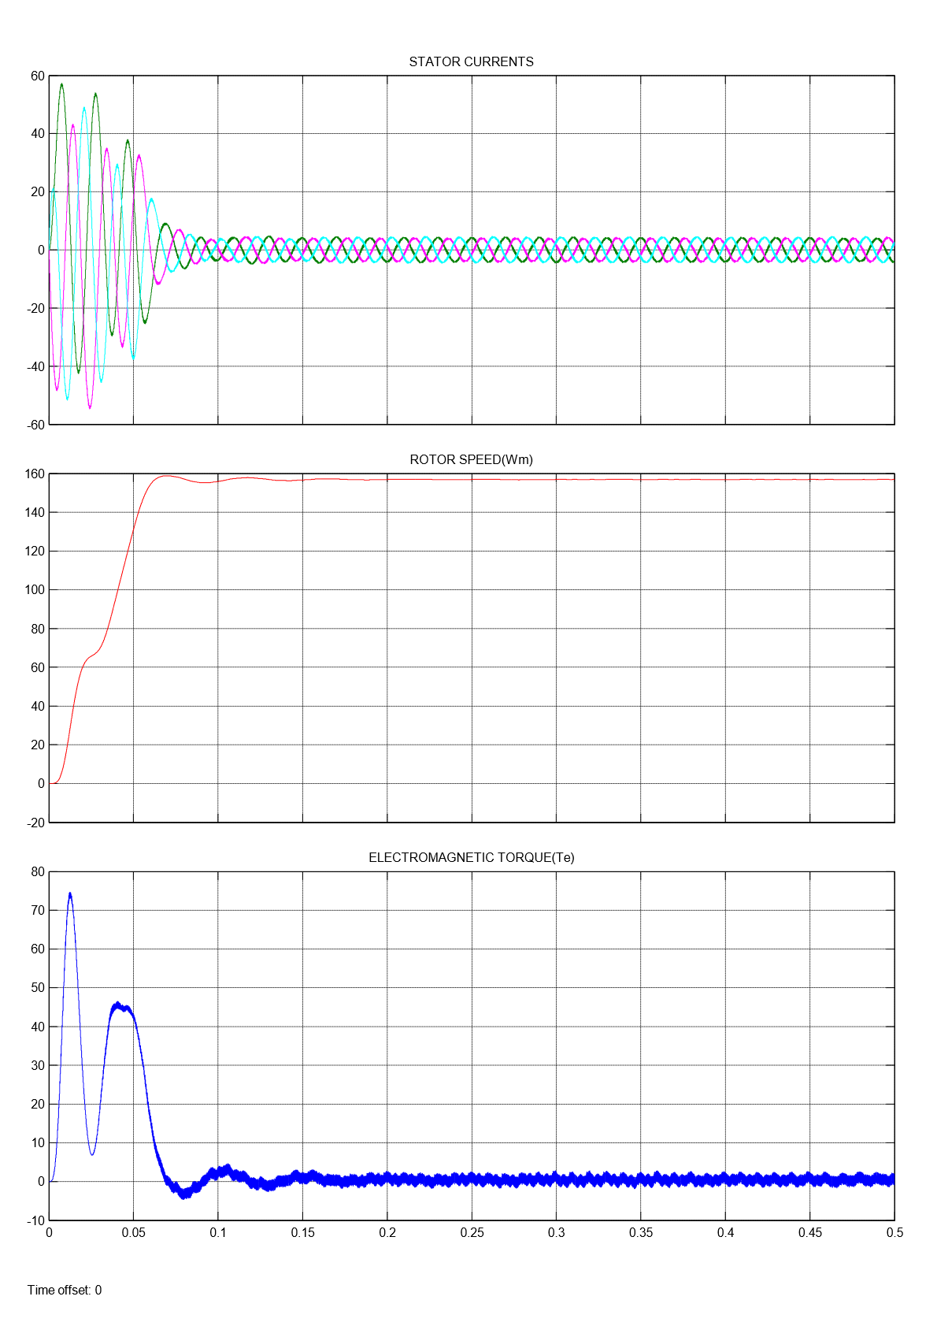
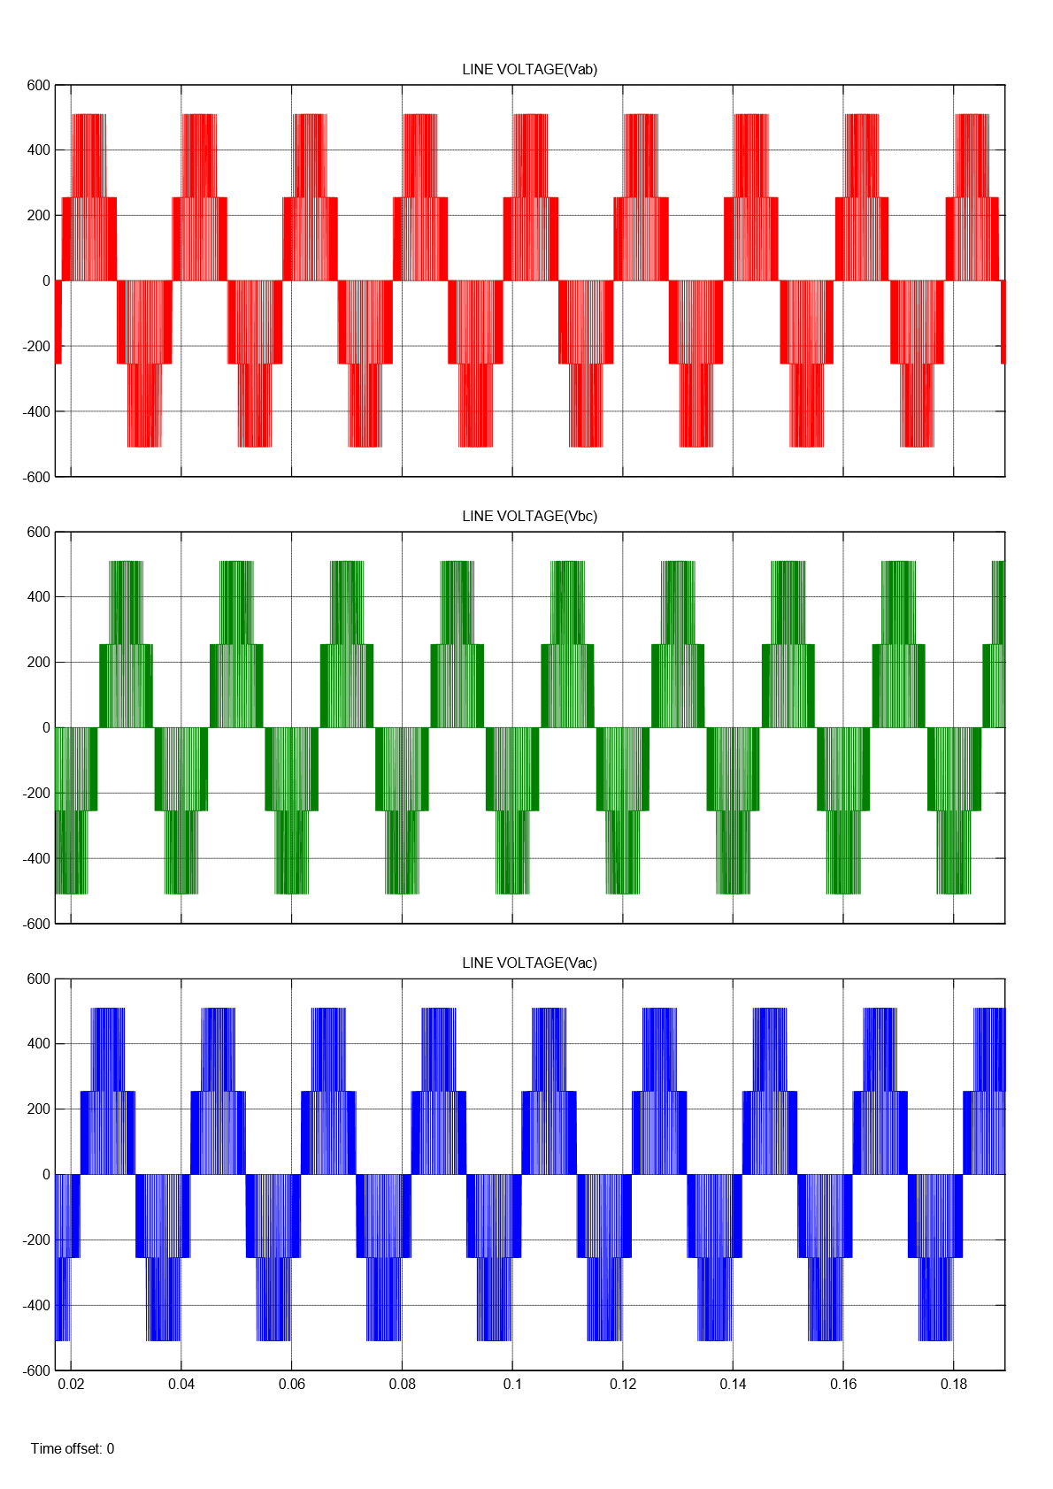
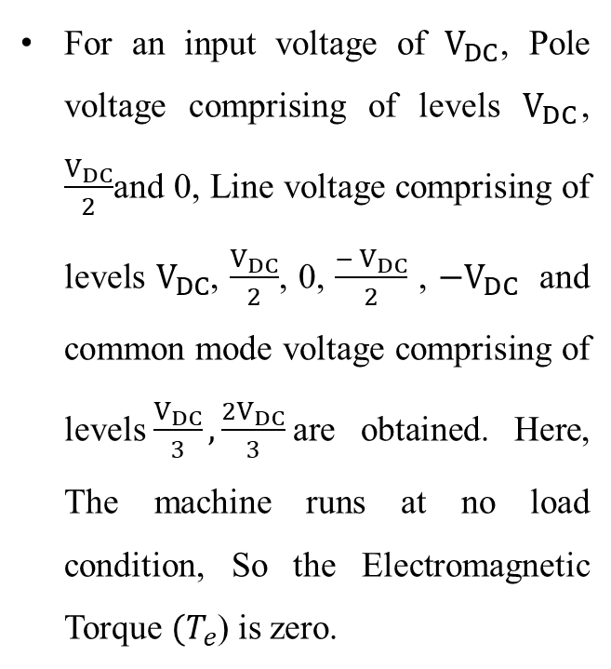
SIMULATION RESULTS (FOR POD):
For an input voltage of $V_{DC}$, Pole voltage comprising of levels $V_{DC}$, $\frac{V_{DC}}{2}$and 0, Line voltage comprising of levels $V_{DC}$, $\frac{V_{DC}}{2}$, 0, $\frac{− V_{DC}}{2}$ , ${−V}_{DC}$ and common mode voltage comprising of levels$\frac{V_{DC}}{3}, \frac{2V_{DC}}{3}$are obtained. Here, The machine runs at no load condition, So the Electromagnetic Torque ${(T}_{e}$) is zero.

Slide 16
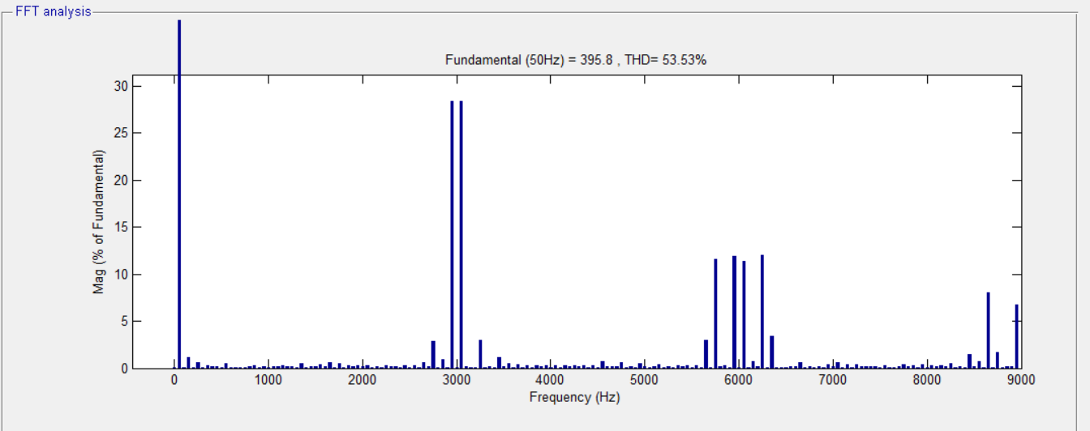
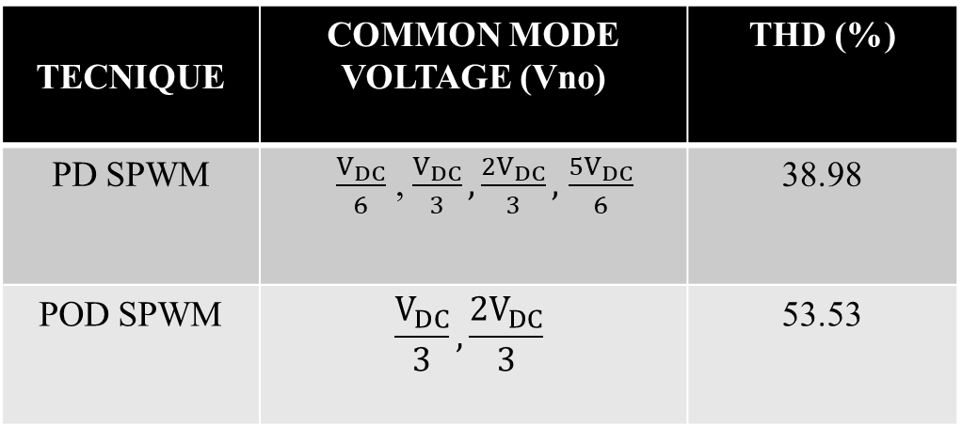
FFT Analysis Three level Inverter (POD SPWM)
TECNIQUE | COMMON MODE VOLTAGE (Vno) | THD (%)
PD SPWM | $\frac{V_{DC}}{6}$ , $\frac{V_{DC}}{3}, \frac{2V_{DC}}{3},$ $\frac{5V_{DC}}{6}$ | 38.98
POD SPWM | $$\frac{V_{DC}}{3}, \frac{2V_{DC}}{3}$$ | 53.53
Results of Three level Inverter

Slide 17
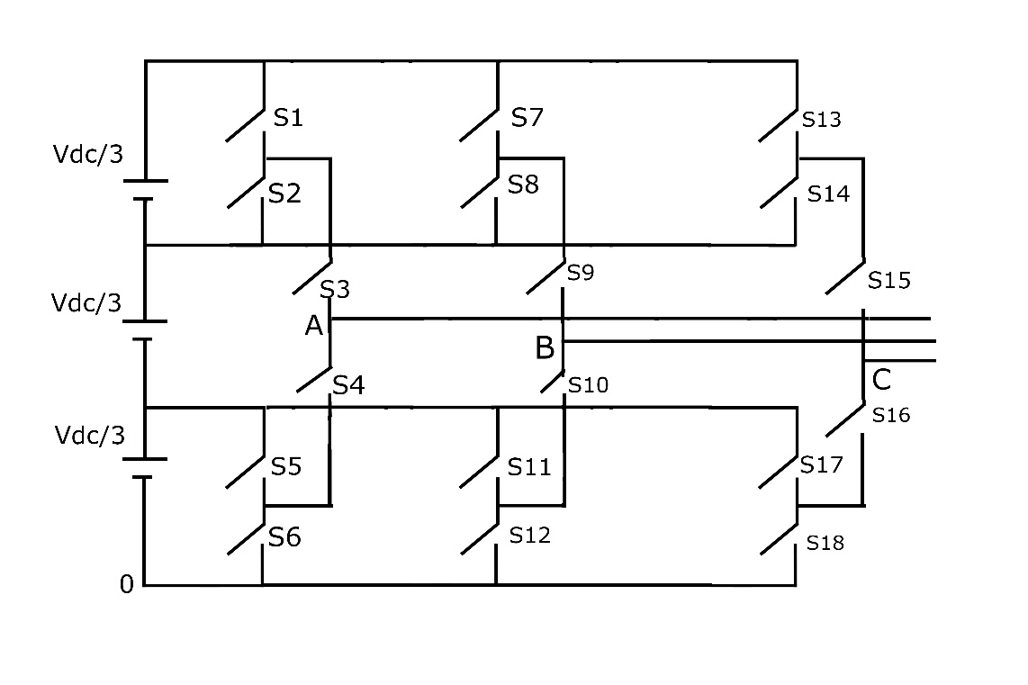
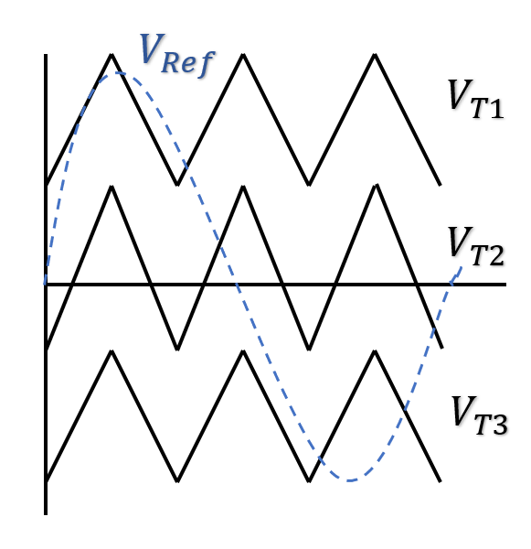
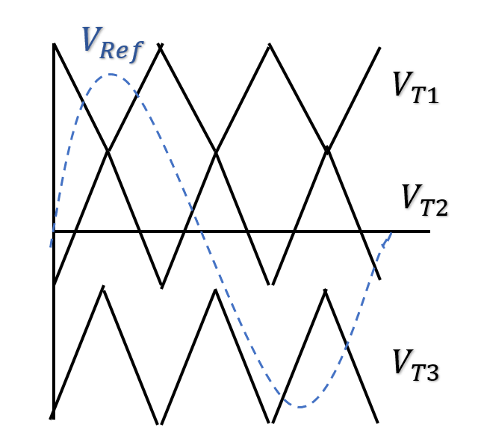
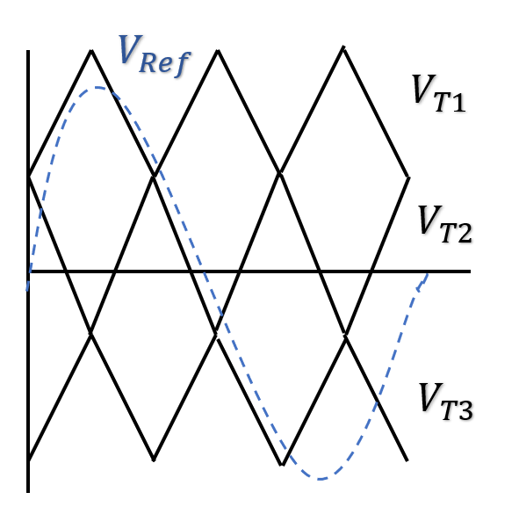
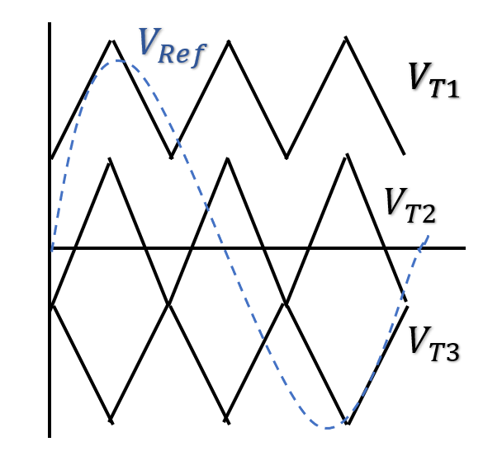
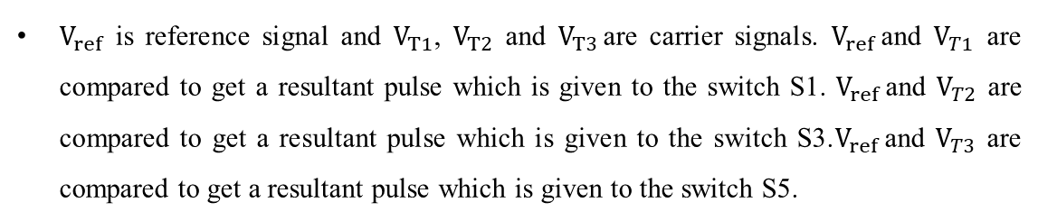
FOUR LEVEL INVERTER
An inverter that produces Four levels in the output pole voltage is called Four level Inverter. A Four level Inverter creates four different voltages for the load i.e, suppose we are providing V as an input to a four level inverter then it will provide either V, 2V/3, V/3 and 0 on output.
Here the level is four so sinusoidal signal is compared with N-1 carrier signals where N is number of levels i.e, sinusoidal signal is compared with three carrier signals.
$V_{ref}$ is reference signal and $V_{T1}$, $V_{T2}$ and $V_{T3 }$are carrier signals. $V_{ref}$and $V_{T1}$ are compared to get a resultant pulse which is given to the switch S1. $V_{ref}$and $V_{T2}$ are compared to get a resultant pulse which is given to the switch S3.$V_{ref}$and $V_{T3}$ are compared to get a resultant pulse which is given to the switch S5.
Fig. Four level Inverter
CARRIER COMPARISION APPROACH
MODE 1
MODE 3
MODE 4
MODE 2

Slide 18
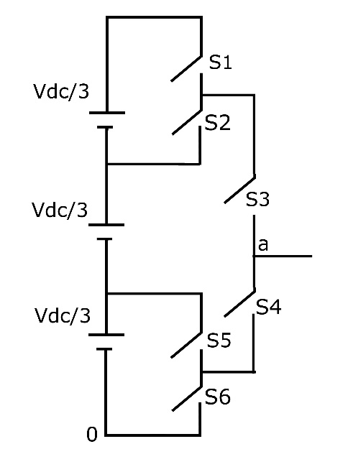
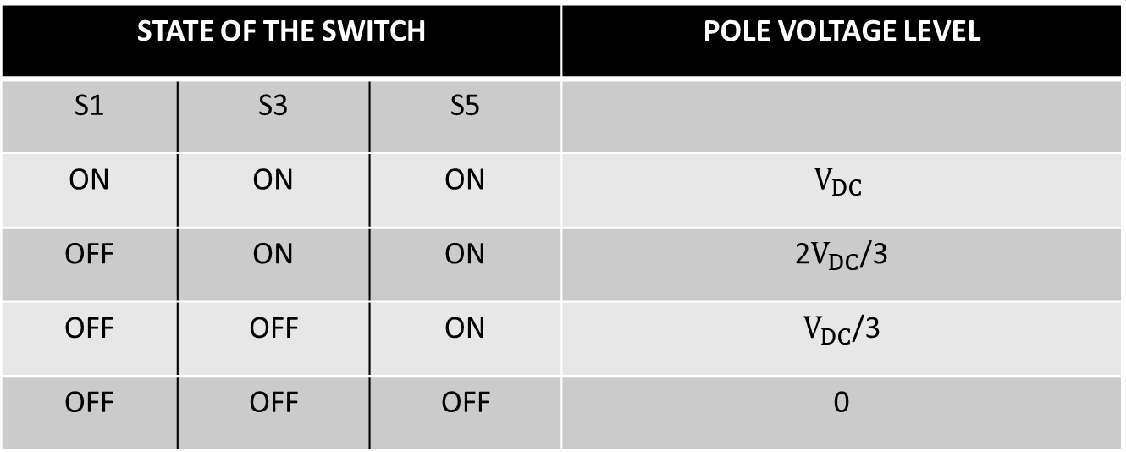
In mode1 all the carrier signals are in same phase. In mode 2, V𝑇1 is in out of phase with other two carrier signals by 180°. In mode 3, V𝑇2 is in out of phase with other two carrier signals by 180°. In mode 4, V𝑇3 is in out of phase with other two carrier signals by 180°.
STATE OF THE SWITCH |  |  | POLE VOLTAGE LEVEL
S1 | S3 | S5
ON | ON | ON | $$V_{DC}$$
OFF | ON | ON | 2$V_{DC}$/3
OFF | OFF | ON | $V_{DC}$/3
OFF | OFF | OFF | 0
Fig. Single leg circuit
S1-S2, S3-S4 and S5-S6 are the complementary pairs of switches.

Slide 19
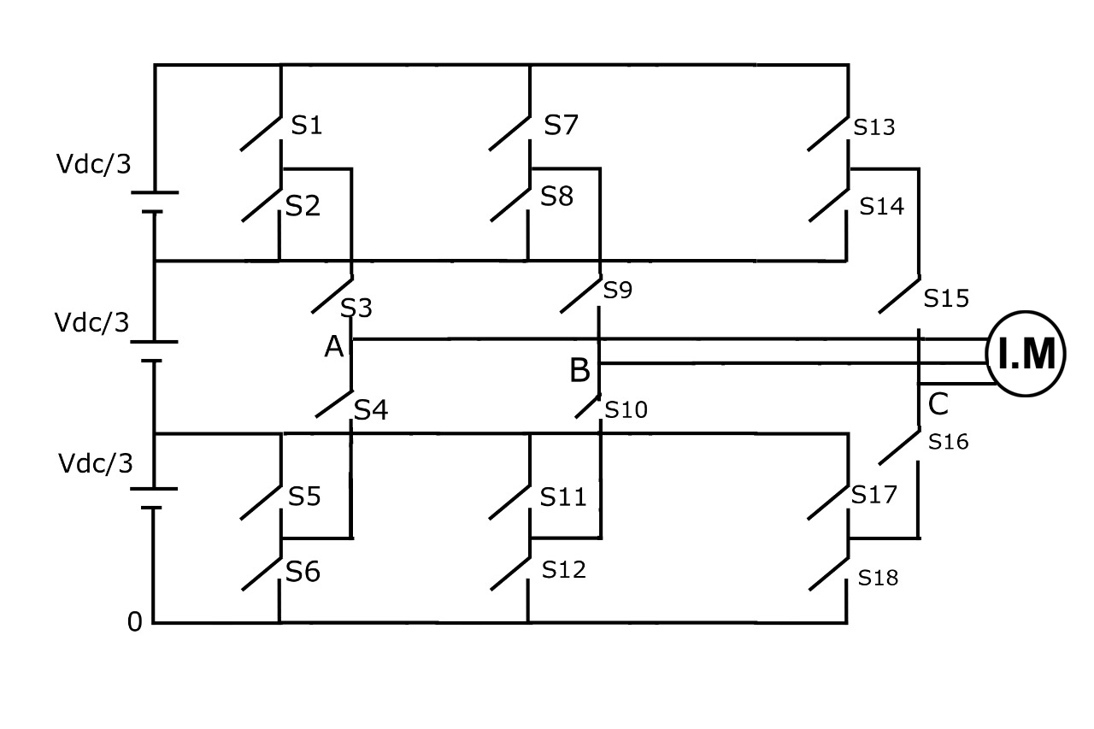
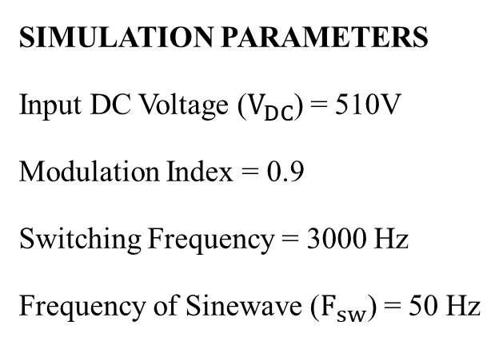
SIMULATION PARAMETERS
Input DC Voltage ($V_{DC}$) = 510V
Modulation Index = 0.9
Switching Frequency = 3000 Hz
Frequency of Sinewave ($F_{sw}$) = 50 Hz
Fig. Four level Inverter fed Induction Motor drive

Slide 20
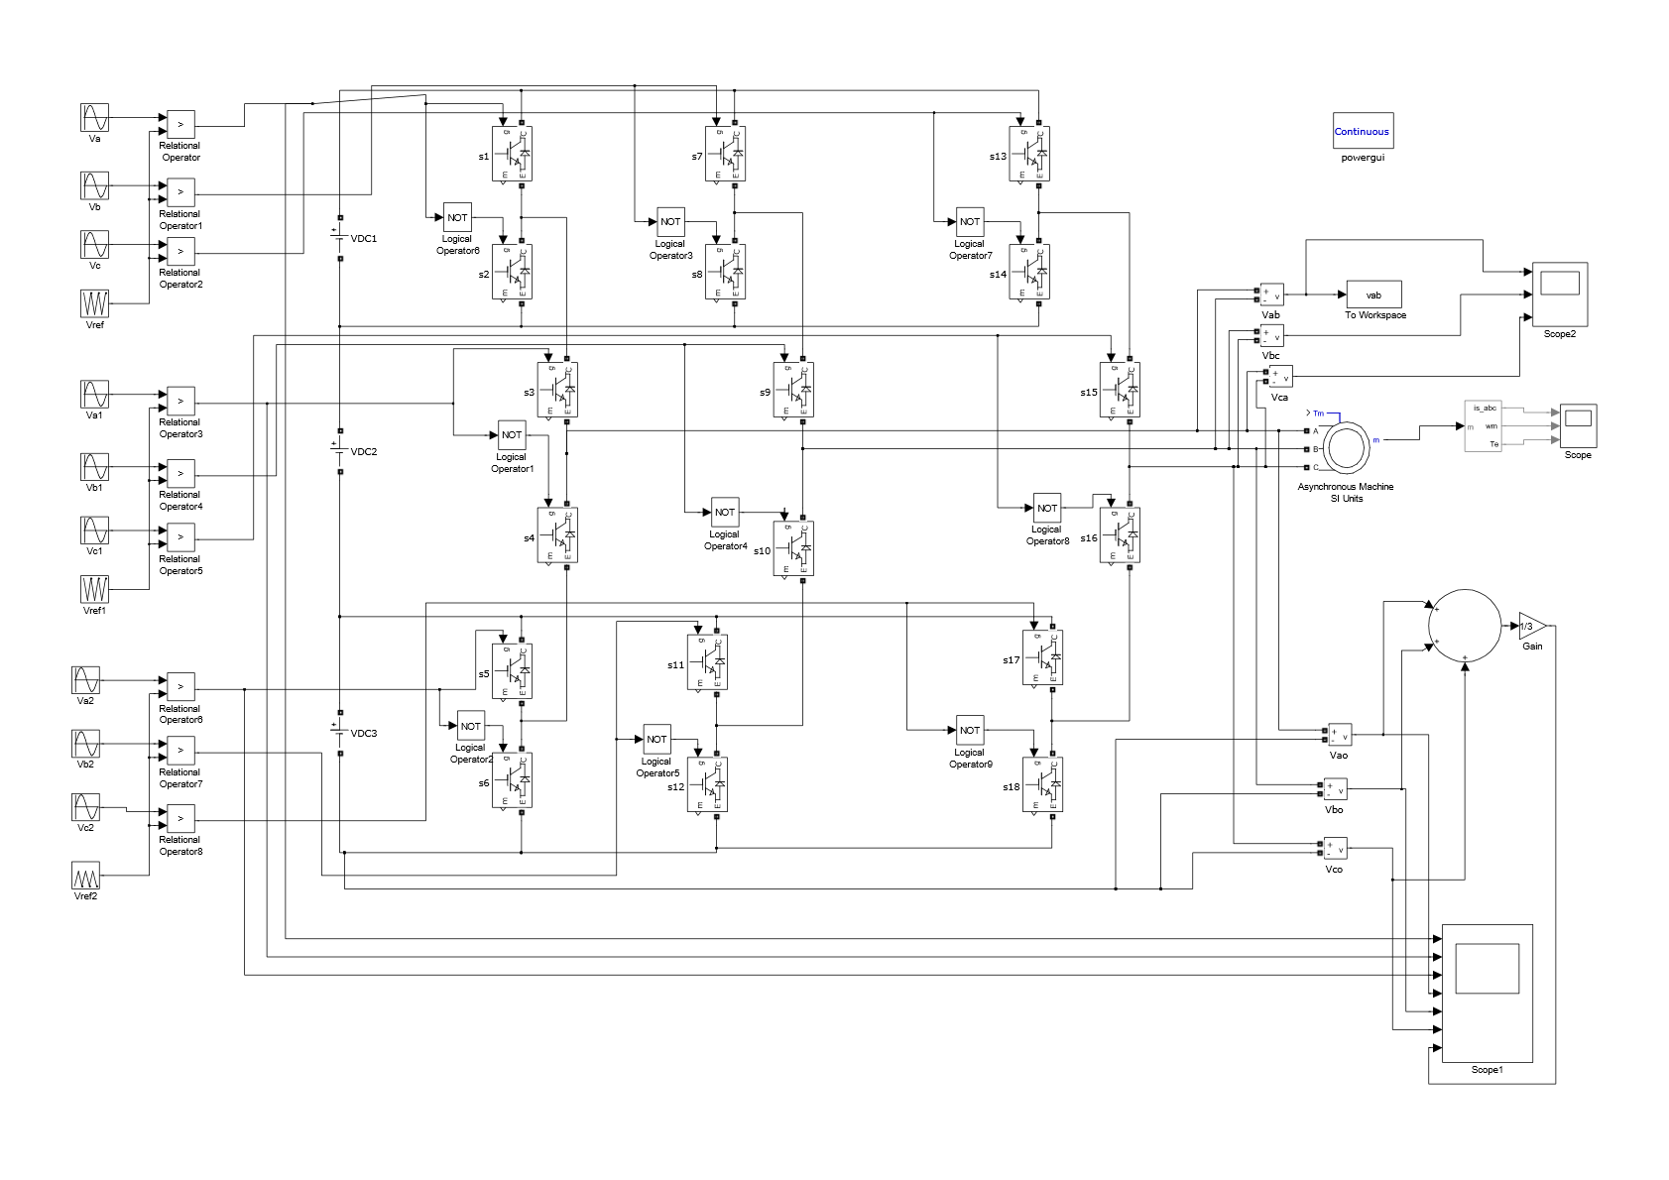
SIMULATION MODEL
Fig. Simulink Model of Four level Inverter fed Induction Motor drive

Slide 21
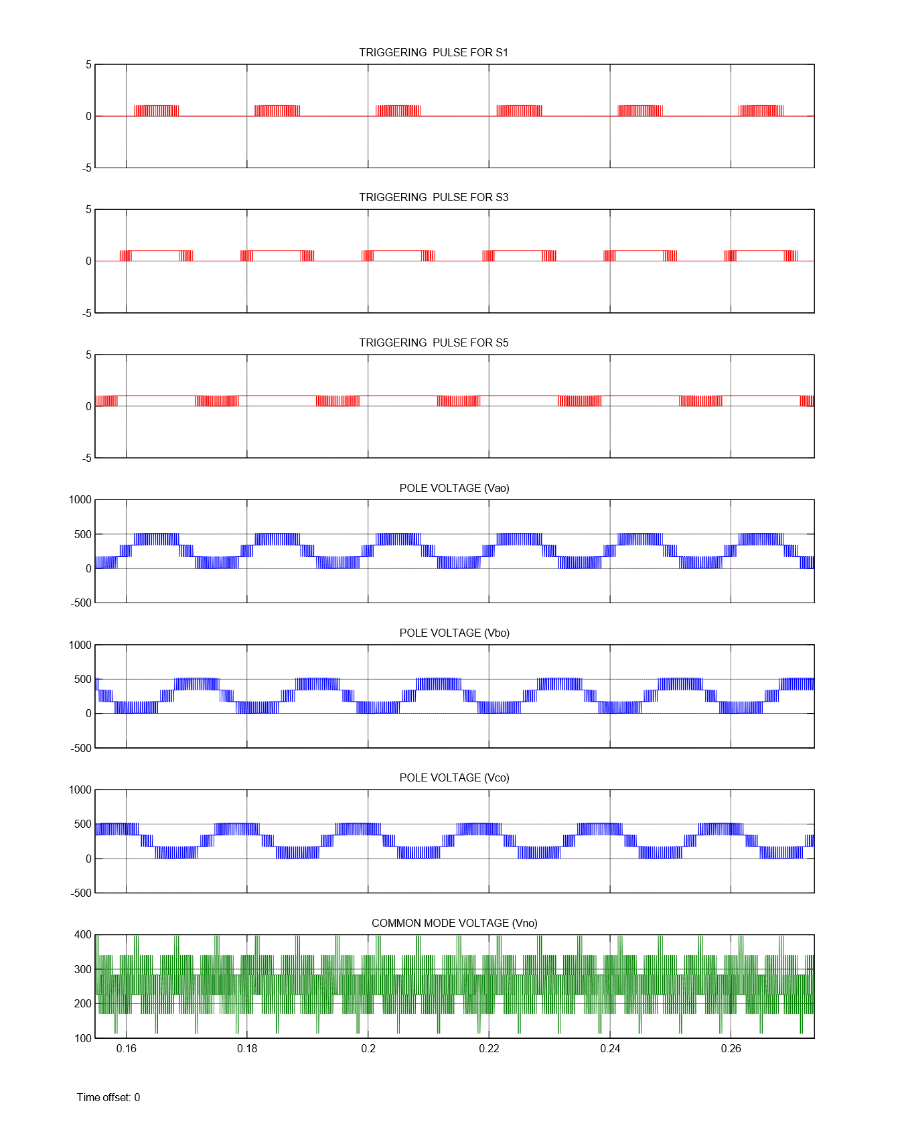
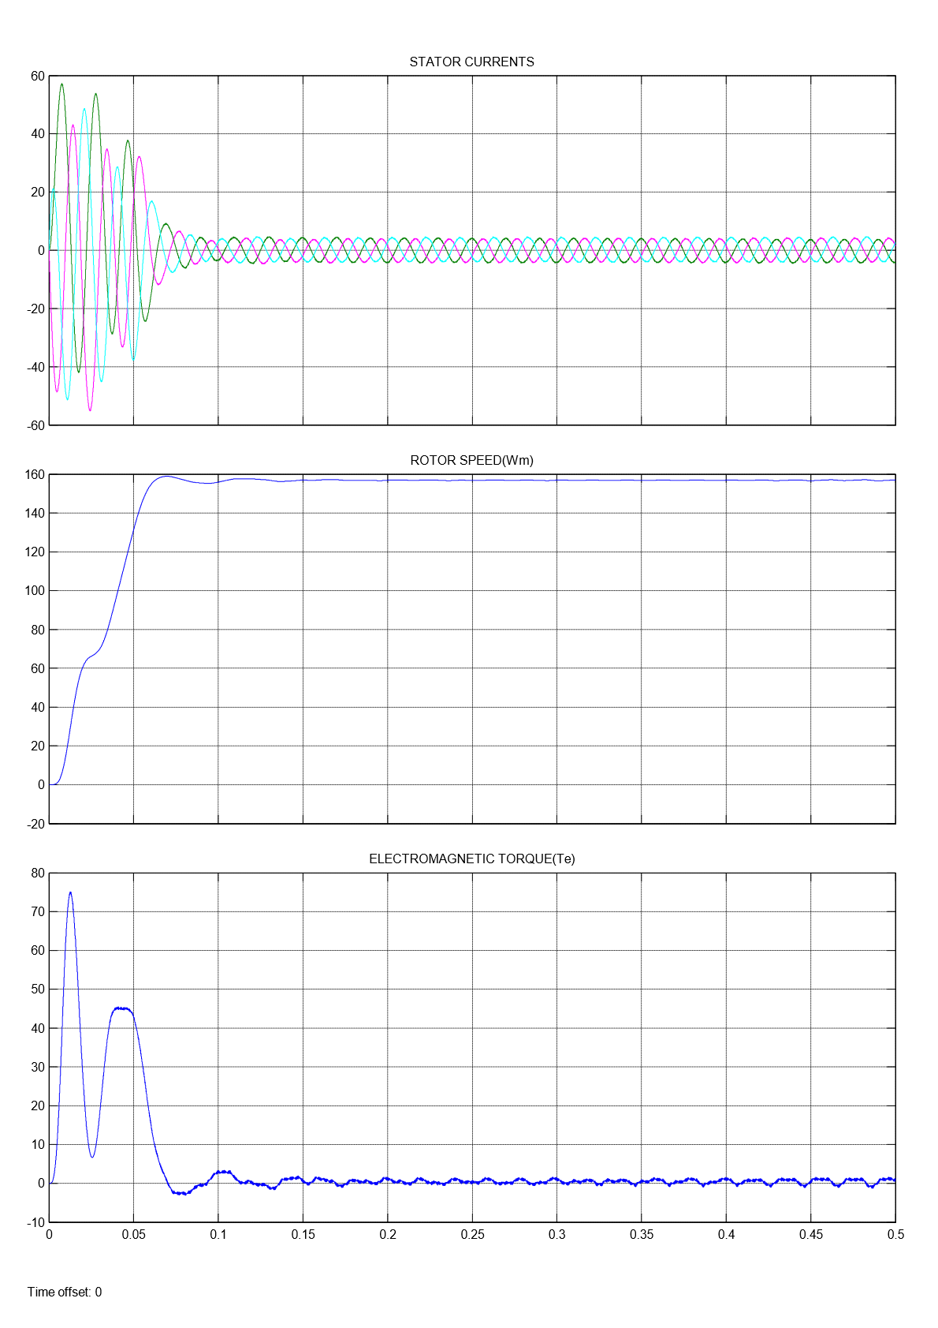
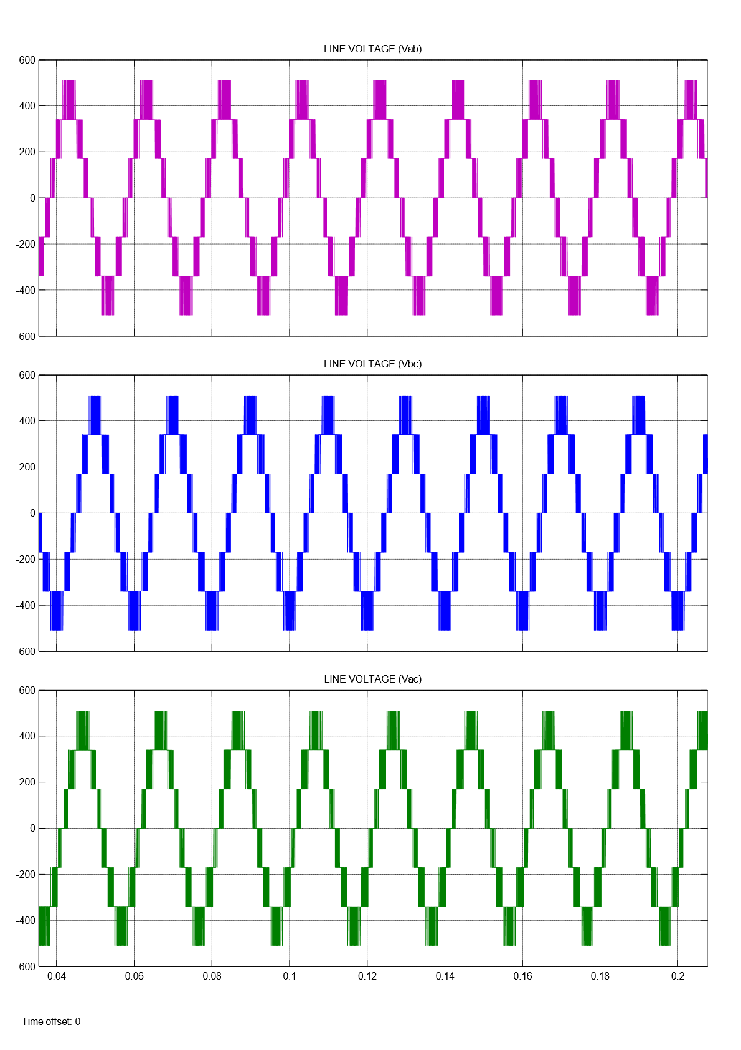
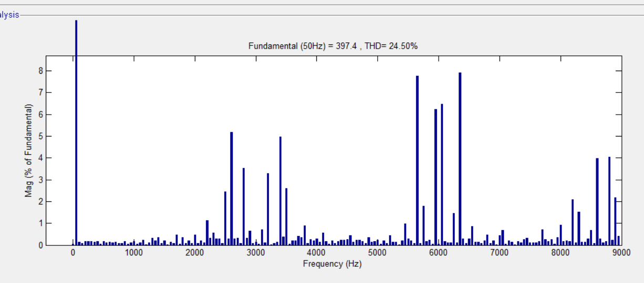
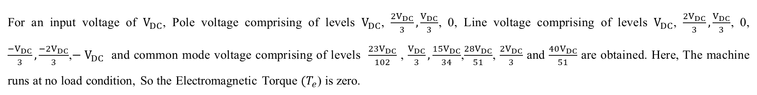
SIMULATION RESULTS (MODE 1):
FFT Analysis Four level Inverter (Mode 1)
For an input voltage of $V_{DC}$, Pole voltage comprising of levels $V_{DC}$, $\frac{{2V}_{DC}}{3}, \frac{V_{DC}}{3}$, 0, Line voltage comprising of levels $V_{DC}$, $\frac{{2V}_{DC}}{3}, \frac{V_{DC}}{3}$, 0, $\frac{{−V}_{DC}}{3}, \frac{{−2V}_{DC}}{3}$,$− V_{DC}$ and common mode voltage comprising of levels $\frac{23V_{DC}}{102}$ , $\frac{V_{DC}}{3}, \frac{15V_{DC}}{34}$,$\frac{28V_{DC}}{51}$, $\frac{2V_{DC}}{3}$ and $\frac{40V_{DC}}{51}$ are obtained. Here, The machine runs at no load condition, So the Electromagnetic Torque ${(T}_{e}$) is zero.

Slide 22
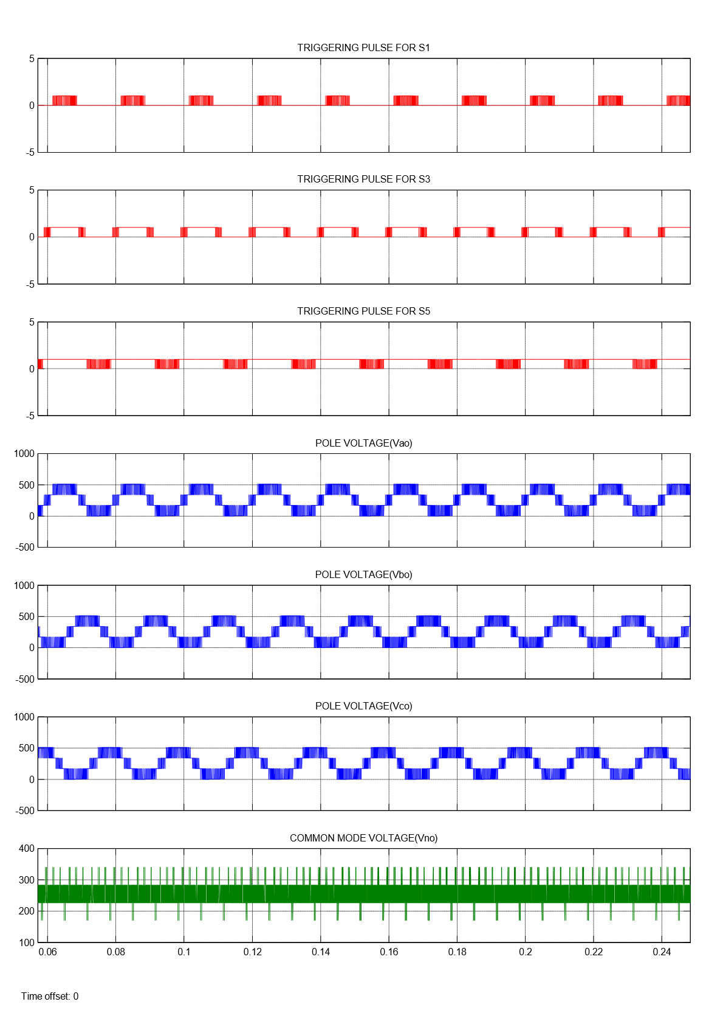
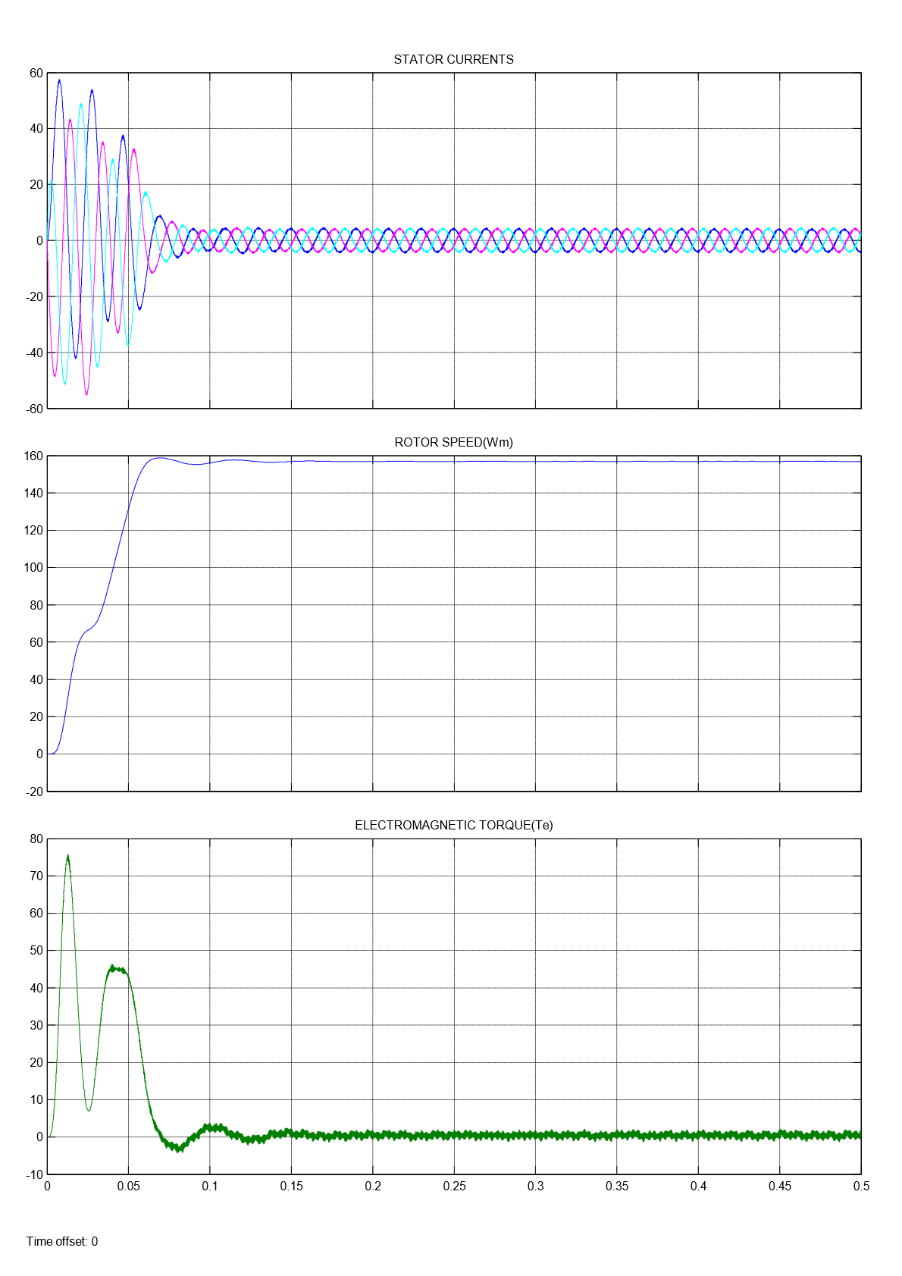
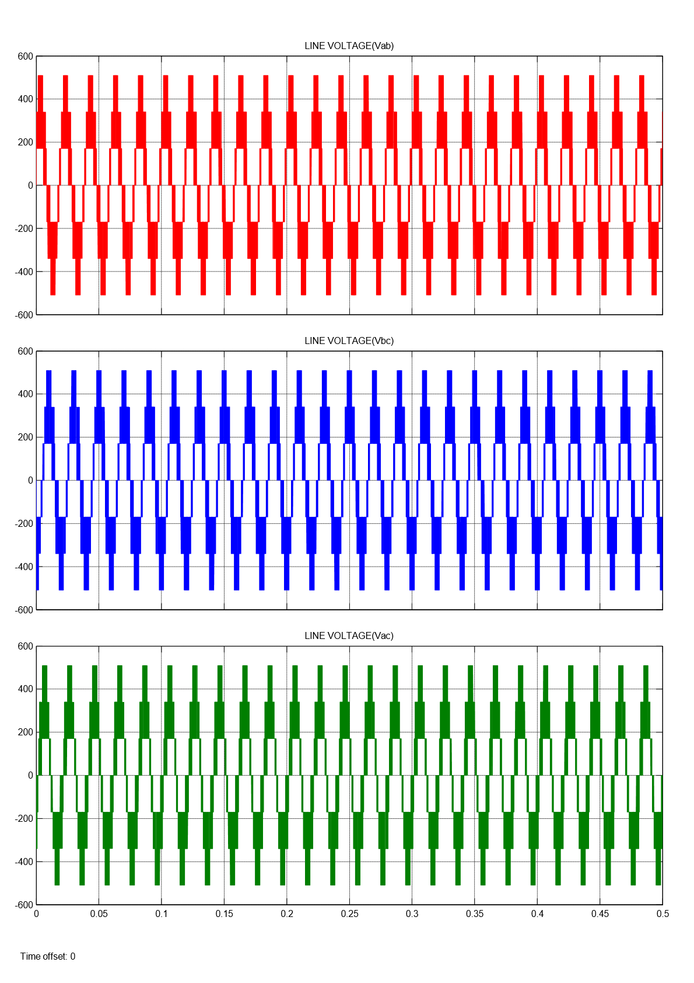
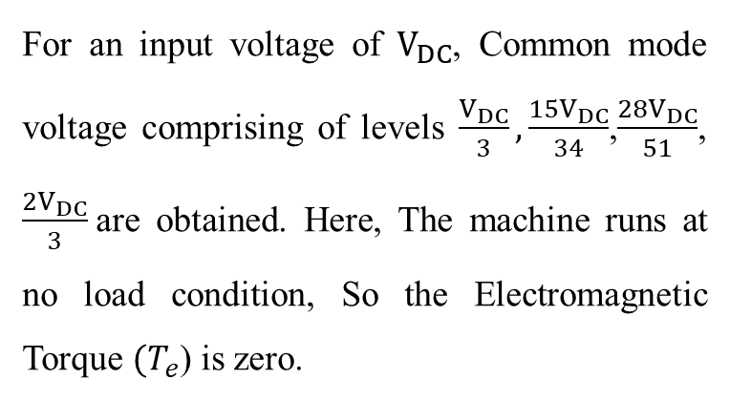
SIMULATION RESULTS (MODE 2):
For an input voltage of $V_{DC}$, Common mode voltage comprising of levels $\frac{V_{DC}}{3}, \frac{15V_{DC}}{34}$,$\frac{28V_{DC}}{51}$, $\frac{2V_{DC}}{3}$are obtained. Here, The machine runs at no load condition, So the Electromagnetic Torque ${(T}_{e}$) is zero.

Slide 23




SIMULATION RESULTS (MODE 3):
For an input voltage of $V_{DC}$, Common mode voltage comprising of levels $\frac{23V_{DC}}{102}$ , $\frac{V_{DC}}{3}, \frac{15V_{DC}}{34}$,$\frac{28V_{DC}}{51}$, $\frac{2V_{DC}}{3}$ and $\frac{40V_{DC}}{51}$ are obtained. Here, The machine runs at no load condition, So the Electromagnetic Torque ${(T}_{e}$) is zero.

Slide 24




SIMULATION RESULTS (MODE 4):
For an input voltage of $V_{DC}$, Common mode voltage comprising of levels $\frac{V_{DC}}{3}, \frac{15V_{DC}}{34}$,$\frac{28V_{DC}}{51}$, $\frac{2V_{DC}}{3}$are obtained. Here, The machine runs at no load condition, So the Electromagnetic Torque ${(T}_{e}$) is zero.

Slide 25

Results of Four level Inverter
MODE | COMMON MODE VOLTAGE (Vno) | THD (%)
1 | $\frac{23V_{DC}}{102}$ , $\frac{V_{DC}}{3}, \frac{15V_{DC}}{34}$,$\frac{28V_{DC}}{51}$, $\frac{2V_{DC}}{3}$ , $\frac{40V_{DC}}{51}$ | 24.50
2 | $\frac{V_{DC}}{3}, \frac{15V_{DC}}{34}$,$\frac{28V_{DC}}{51}$, $\frac{2V_{DC}}{3}$ | 39.17
3 | $\frac{23V_{DC}}{102}$ , $\frac{V_{DC}}{3}, \frac{15V_{DC}}{34}$,$\frac{28V_{DC}}{51}$, $\frac{2V_{DC}}{3}$ , $\frac{40V_{DC}}{51}$ | 36.55
4 | $\frac{V_{DC}}{3}, \frac{15V_{DC}}{34}$,$\frac{28V_{DC}}{51}$, $\frac{2V_{DC}}{3}$ | 39.34
In Mode 2 and Mode 4 Common mode voltage is reduced but THD increased. Whereas in Mode 3 Common mode voltage is same as mode 1 but THD is increased this is disadvantage.

Slide 26




FIVE LEVEL INVERTER
An inverter that produces five levels in the output pole voltage is called Five level Inverter. A Five level Inverter creates five different voltages for the load.
Here the level is five so sinusoidal signal is compared with N-1 carrier signals where N is number of levels i.e, sinusoidal signal is compared with four carrier signals.
$V_{ref}$and $V_{T1}$ are compared to get a resultant pulse which is given to the switch S1. $V_{ref}$and $V_{T2}$ are compared to get a resultant pulse which is given to the switch S3.$V_{ref}$and $V_{T3}$ are compared to get a resultant pulse which is given to the switch S4. $V_{ref}$and $V_{T4}$ are compared to get a resultant pulse which is given to the switch S7.
Fig. Five level Inverter
CARRIER COMPARISION APPROACH
PD POD APOD

Slide 27

In Phase Disposition all the carrier signals are in same phase. In Phase Opposition Disposition all the carrier signals above the zero are out of phase with those below the zero by 180°. In Alternate Phase Opposition Disposition all the adjacent carrier signals are out of phase by 180°
STATE OF THE SWITCH |  |  |  | POLE VOLTAGE LEVEL
S1 | S3 | S6 | S7
ON | ON | OFF | ON | V1
OFF | ON | OFF | ON | V2
OFF | OFF | OFF | ON | 0
OFF | OFF | ON | ON | V3
OFF | OFF | ON | OFF | V4
Fig.Single leg circuit
S1-S2, S3-S5, S4-S6 and S7-S8 are the complementary pairs of switches.

Slide 28


SIMULATION PARAMETERS
Input DC Voltage ($V_{DC}$) = 510V
Modulation Index = 0.9
Switching Frequency = 3000 Hz
Frequency of Sinewave ($F_{sw}$) = 50 Hz
Fig. Five level Inverter fed Induction Motor Drive

Slide 29

SIMULATION MODEL
Fig. Simulink Model of Five level Inverter fed Induction Motor Drive

Slide 30






SIMULATION RESULTS (PD):
Here, The machine runs at no load condition, So the Electromagnetic Torque ${(T}_{e}$) is zero.
For an input voltage of $V_{DC}$, Pole voltage comprising of levels $\frac{V_{DC}}{2}$,$\frac{V_{DC}}{4}$, 0, $\frac{{−V}_{DC}}{4}, \frac{{−V}_{DC}}{2}$, Line voltage comprising of levels $V_{DC}$,$\frac{{38V}_{DC}}{51}, \frac{V_{DC}}{2}$,$\frac{V_{DC}}{4}$, 0, $\frac{{−V}_{DC}}{4}, \frac{{−V}_{DC}}{2}, \frac{−38V_{DC}}{51}$,$− V_{DC}$ and common mode voltage comprising of levels $\frac{V_{DC}}{6}, \frac{V_{DC}}{12}$, $\frac{{−V}_{DC}}{12}$, $\frac{{− V}_{DC}}{6}$ are obtained.

Slide 31




SIMULATION RESULTS (POD):
For an input voltage of $V_{DC}$, common mode voltage comprising of level$\frac{V_{DC}}{12}$, $\frac{{−V}_{DC}}{12}$are obtained. Here, The machine runs at no load condition, So the Electromagnetic Torque ${(T}_{e}$) is zero.

Slide 32




SIMULATION RESULTS (APOD):
For an input voltage of $V_{DC}$, common mode voltage comprising of level$\frac{V_{DC}}{12}$, $\frac{{−V}_{DC}}{12}$are obtained. Here, The machine runs at no load condition, So the Electromagnetic Torque ${(T}_{e}$) is zero.

Slide 33

Results of Five level Inverter
TECHNIQUE | COMMON MODE VOLTAGE (Vno) | THD (%)
PD SPWM | $\frac{V_{DC}}{6}, \frac{V_{DC}}{12}$, $\frac{{−V}_{DC}}{12}$, $\frac{{− V}_{DC}}{6}$ | 17.25
POD SPWM | $\frac{V_{DC}}{12}$, $\frac{{−V}_{DC}}{12}$ | 30.03
APOD SPWM | $\frac{V_{DC}}{12}$, $\frac{{−V}_{DC}}{12}$ | 28.82
In Both POD and APOD techniques common mode voltage levels are same but compared to POD , APOD offers less THD

Slide 34

CONCLUSION
LEVEL | SPWM TECHNIQUE | COMMON MODE VOLTAGE (Vno) | THD(%) LINE VOLTAGE (Vab)
TWO | PD | 0, $\frac{V_{DC}}{3}$ , $\frac{2V_{DC}}{3}$ , $V_{DC}$ | 79.43
THREE | PD | $\frac{V_{DC}}{6}$ , $\frac{V_{DC}}{3}, \frac{2V_{DC}}{3},$ $\frac{5V_{DC}}{6}$ | 38.98
 | POD | $\frac{V_{DC}}{3}, \frac{2V_{DC}}{3}$ | 53.53
FOUR | MODE 1 | $\frac{23V_{DC}}{102}$ , $\frac{V_{DC}}{3}, \frac{15V_{DC}}{34}$,$\frac{28V_{DC}}{51}$, $\frac{2V_{DC}}{3}$ , $\frac{40V_{DC}}{51}$ | 24.50
 | MODE 2 | $\frac{V_{DC}}{3}, \frac{15V_{DC}}{34}$,$\frac{28V_{DC}}{51}$, $\frac{2V_{DC}}{3}$ | 39.17
 | MODE 3 | $\frac{23V_{DC}}{102}$ , $\frac{V_{DC}}{3}, \frac{15V_{DC}}{34}$,$\frac{28V_{DC}}{51}$, $\frac{2V_{DC}}{3}$ , $\frac{40V_{DC}}{51}$ | 36.55
 | MODE 4 | $\frac{V_{DC}}{3}, \frac{15V_{DC}}{34}$,$\frac{28V_{DC}}{51}$, $\frac{2V_{DC}}{3}$ | 39.34
FIVE | PD | $\frac{V_{DC}}{6}, \frac{V_{DC}}{12}$, $\frac{{−V}_{DC}}{12}$, $\frac{{− V}_{DC}}{6}$ | 17.25
 | POD | $\frac{V_{DC}}{12}$, $\frac{{−V}_{DC}}{12}$ | 30.03
 | APOD | $\frac{V_{DC}}{12}$, $\frac{{−V}_{DC}}{12}$ | 28.82
In this project Simulation of Two level, Three level, Four level and Five level Inverter employing different carrier based pulse width modulation techniques such as PD, POD and APOD is implemented. The analysis and variation of Total Harmonic Distortion (THD) and Common Mode Voltage (CMV) of different Multilevel Inverters topologies are plotted and tabulated.

Slide 35
THANK YOU…

